Slide 1



Facilitate High Productivity Dairy Farm in Philippines
Learnings from Vietnam applying Israeli tech
Gonen Harel, Chief Dairy Expert
Kate Francisco , Philippines managing director
www.dairyfresh.asia
Proprietary and confidential information of DairyFresh.Asia

Slide 2
What we will discuss today?
01
Why high productivity farm? Vietnam Dairy story
Becoming best farm in Vietnam: Case Study VNFM with Israeli technology & methods
02
03
Philippines Dairy Farm Project plans
Proprietary and confidential information of FreshDairy.Asia

Slide 3
company profile
30+ years 3rd generation dairy farmers from Israel
Last 10+ years of work with the leading dairy farms in Vietnam
Unique combination of Israeli technology & know-how , localized to southeast asia needs
Build-Operate high productivity dairy farms (Turn-Key , JV or consulting)
Philippines dairy experience and team presence

Slide 4


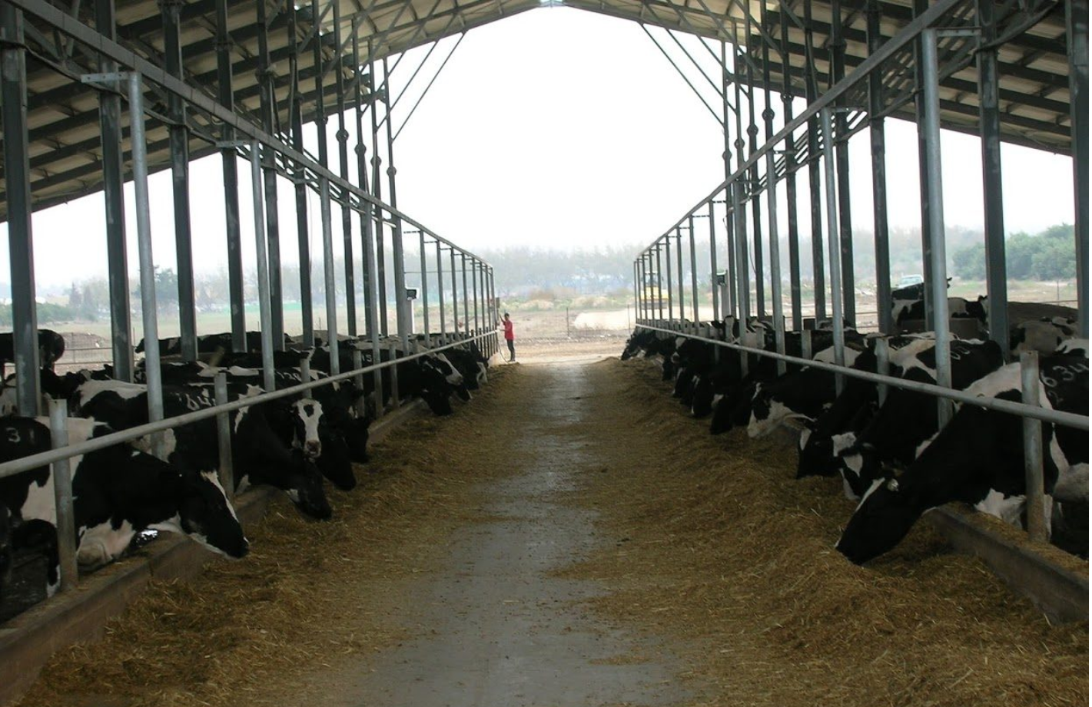


proven success in generating high productivity farms across Asia
Know-how and technology localized to Southeast Asia
DDEF
TH True Milk
Milky Way
Future Milk
Notes:
Out proven south east Asia:
Know-how & expertise
Practices library
Technology
Market knowledge
Lead to:
Maximize profitability
Risks reduction

Slide 5
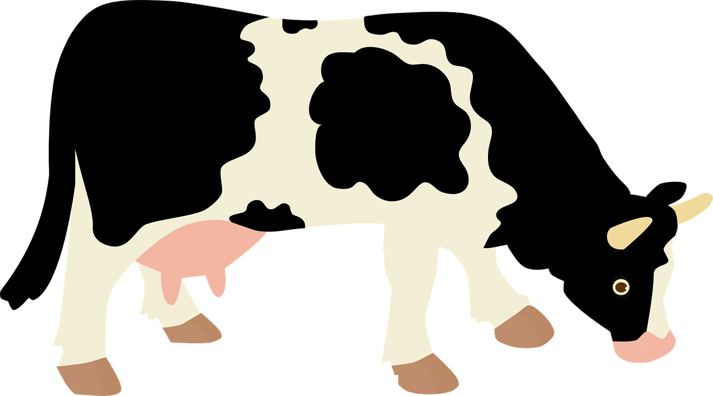

Why to be high productivity farm in Southeast Asia?
High Cow's Productivity provide lower costs per litter & higher Revenues
10 liter/day
Losing Farm
Profitable Farm
12 kg feed
20 liter/day
VS
15 kg feed
10 liter/day
12 kg feed
Total 20 liter and 24 kg feed
Total 20 liter and 15 kg feed

Slide 6
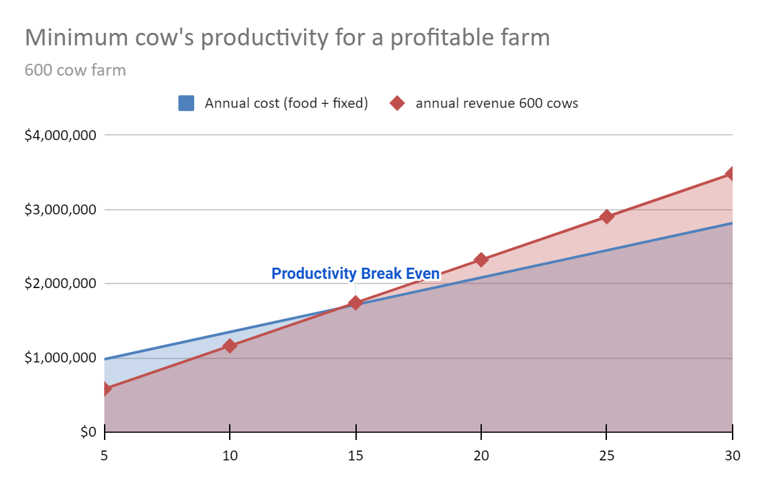
Why Milk Productivity is Critical for Profitability?
Profit
Loss

Slide 7
The best dairy farm in Vietnam: VNFM
35 Litter cow/day
best in Vietnam
Started with 200 cows
Now more than 800 cows
Highly
profitable
High Productivity Farm
Automated & Operated by minimal staff
Fresh Milk
3 times a day production
High Technology
Used to monitor and improve every aspect of the farm
Localize Israeli technology and methods to southeast Asia ecosystem
CoOp with community
Train and employ local talent, buy corn and feed from nearby farmers

Slide 8
Vietnam & Philippines unique ecosystem
Key to High Productivity & Profitability in VNFM
Nutrition
All year Hot & Humid weather
Inconsistent nutrition supply
Cost-effective solutions
Lack of expertise / technology
Cow’s genetics
Management
know-how
technology
Fertility & Health
Cows comfort

Slide 9
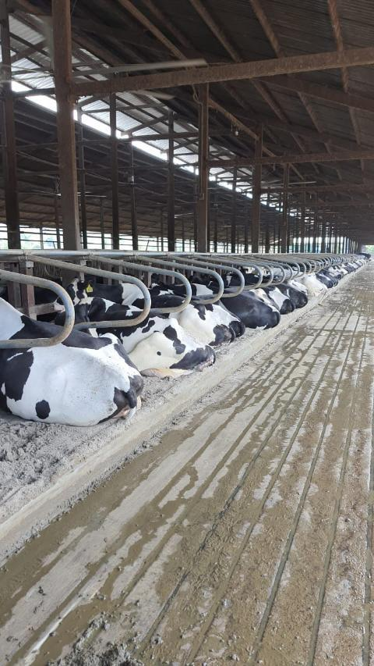
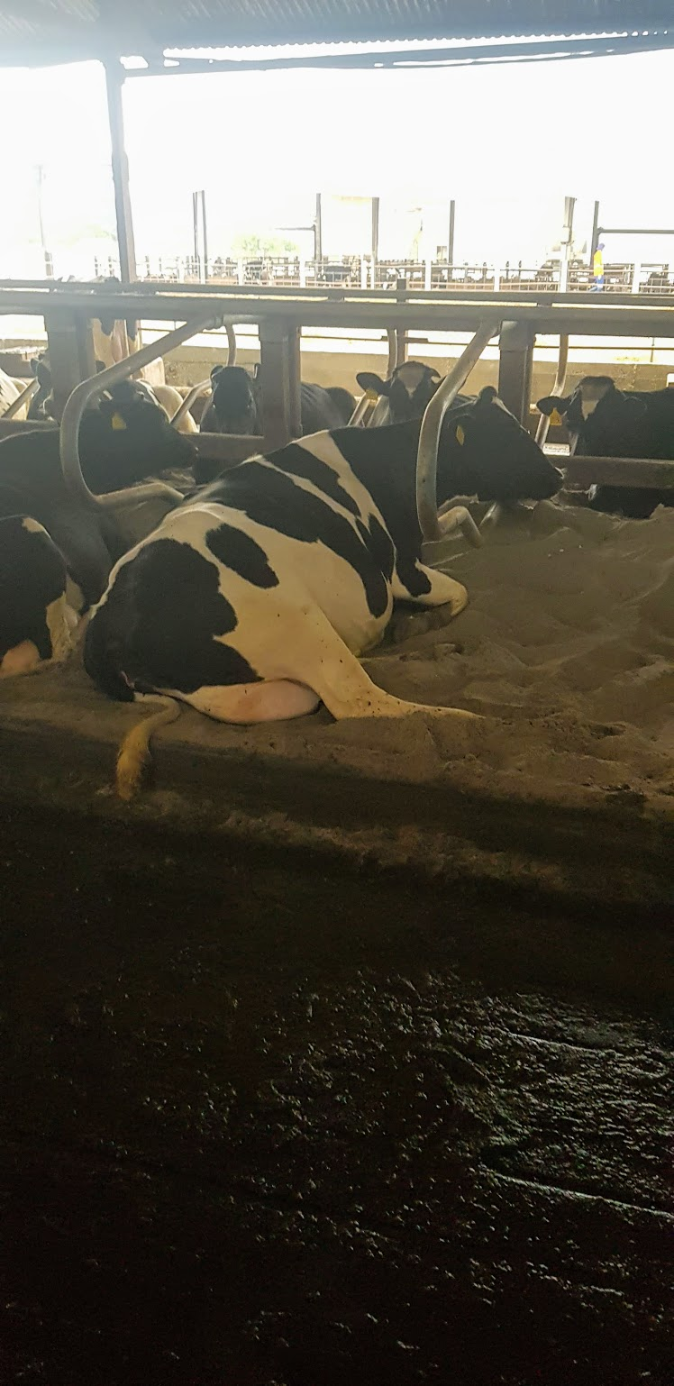
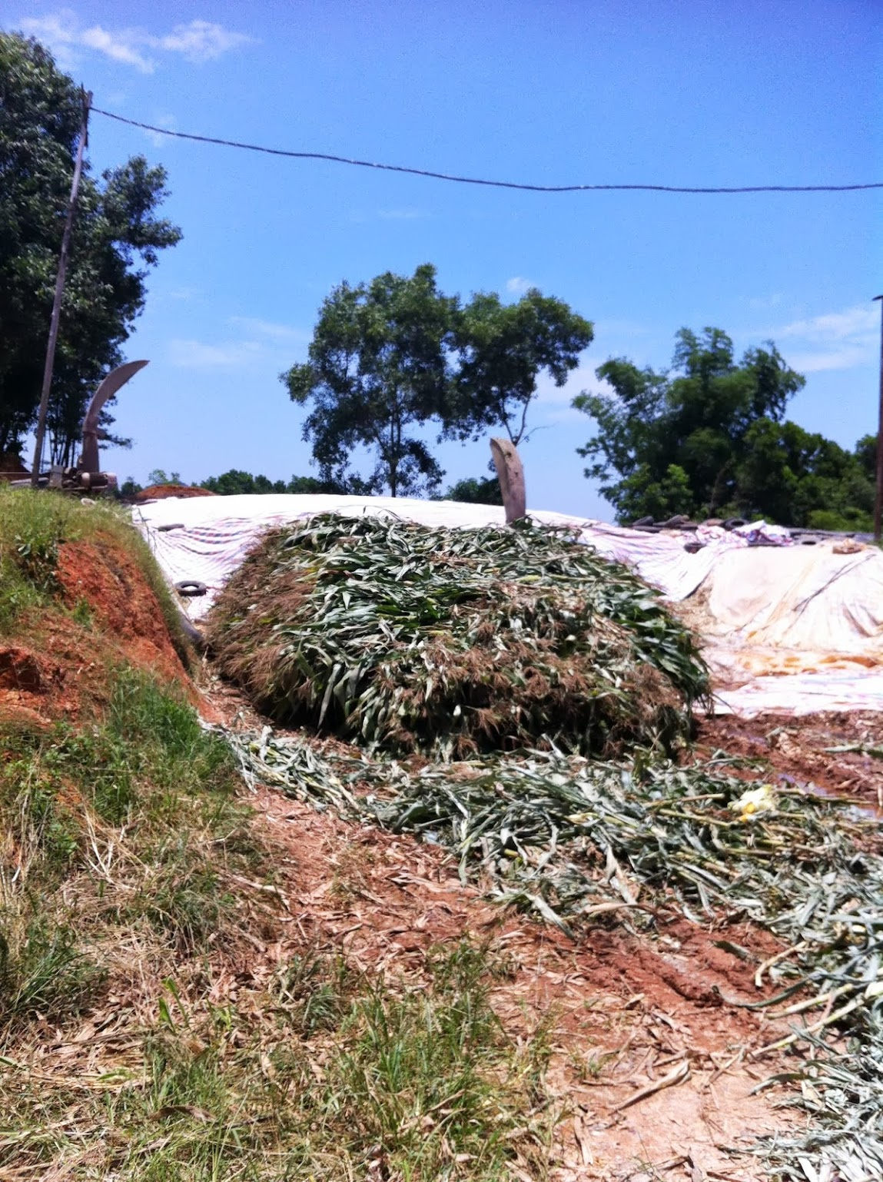
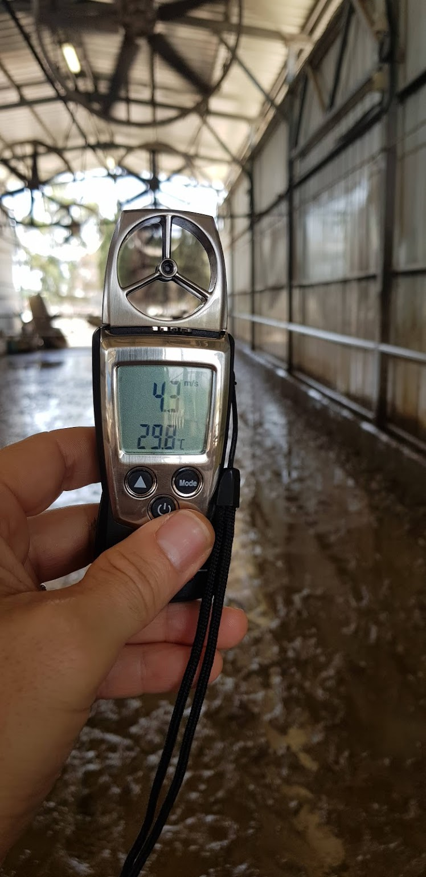
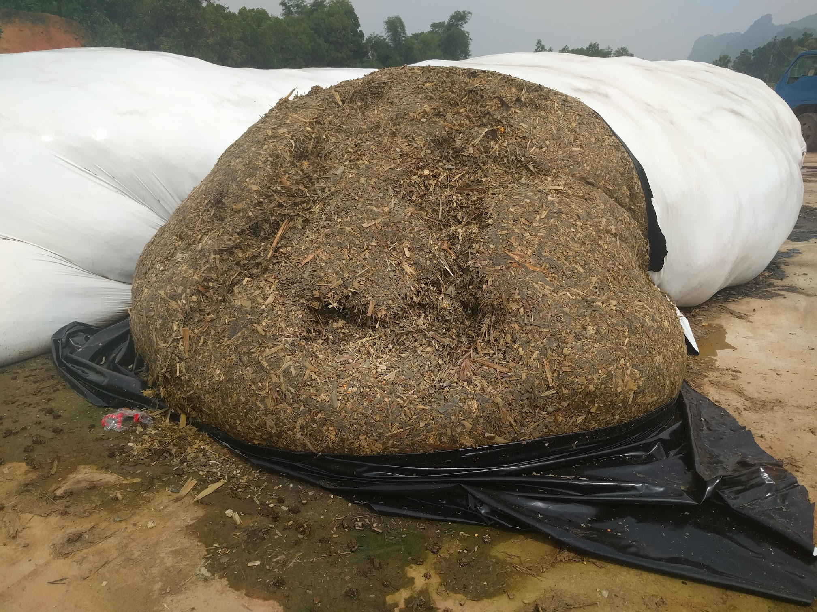
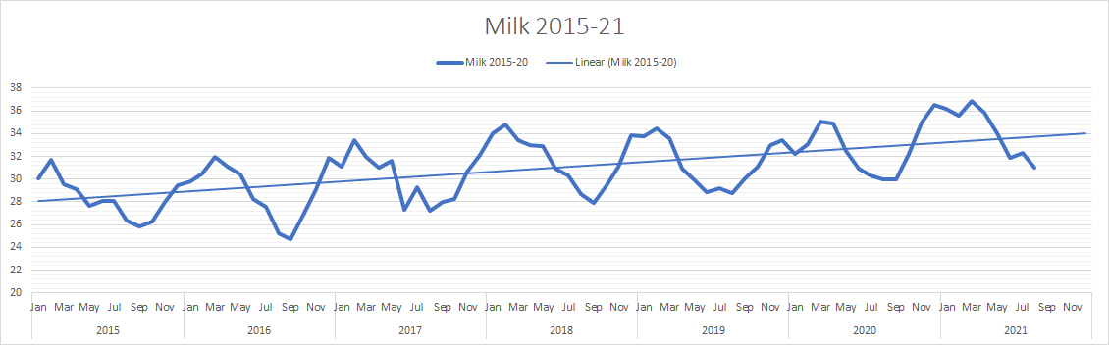
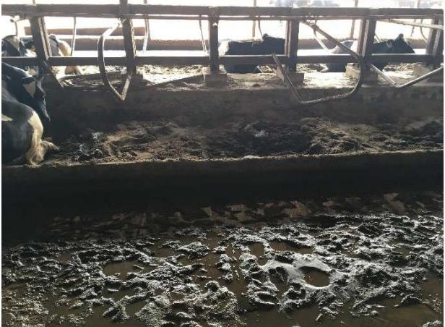
VNFM Milk Production from 2015 till now
Improving Silage quality
Adding Cooling Tunnel
Improving Cows Comfort
Proprietary and confidential information of FreshDairy.Asia

Slide 10
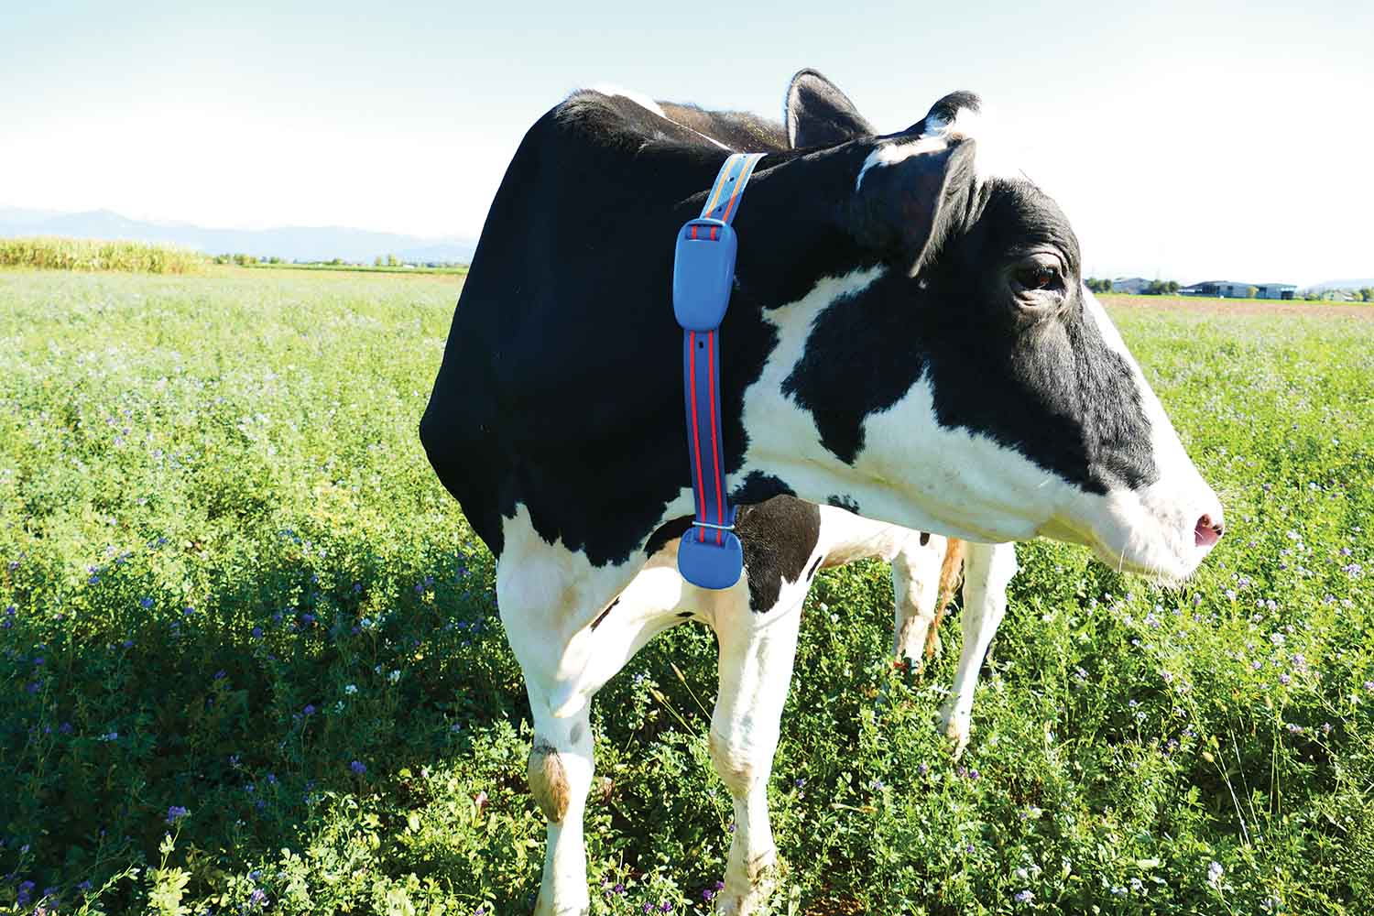
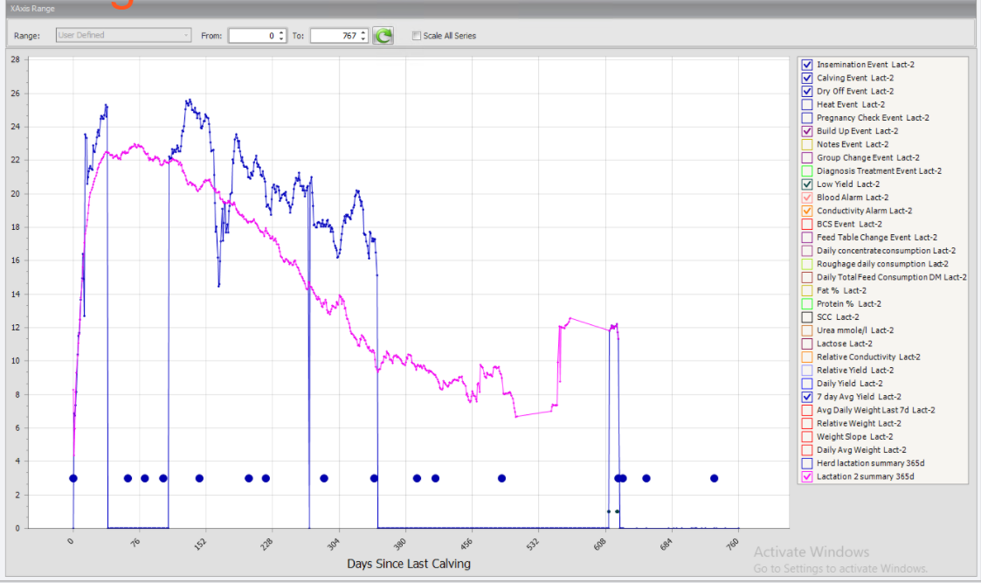
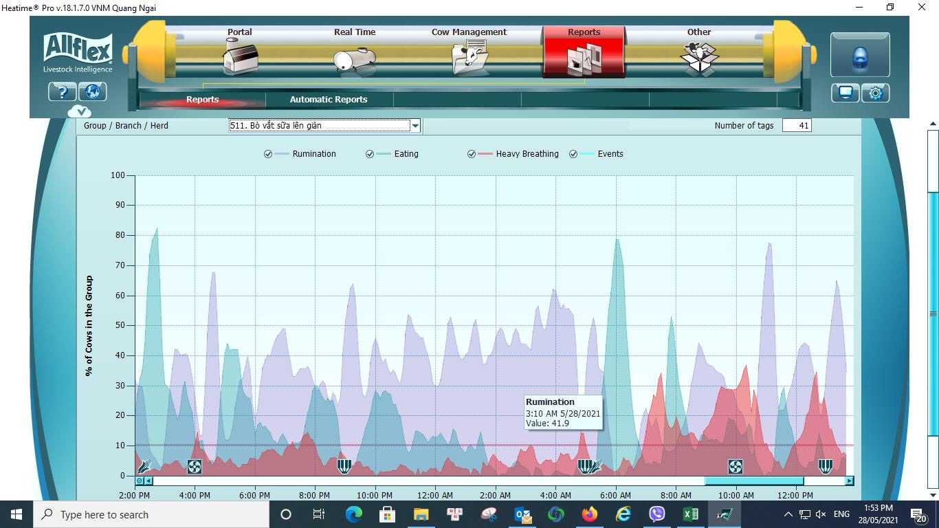
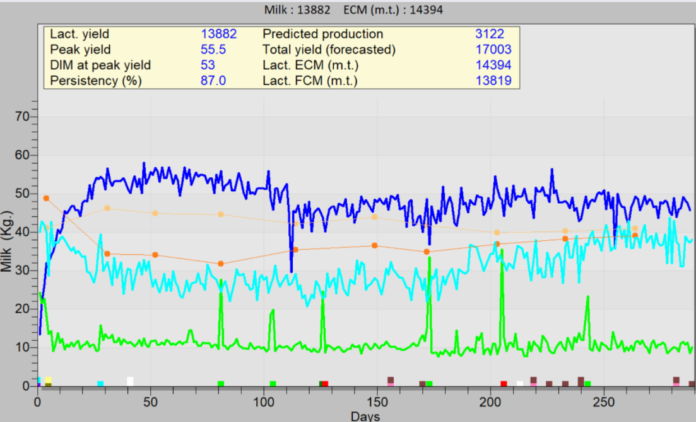
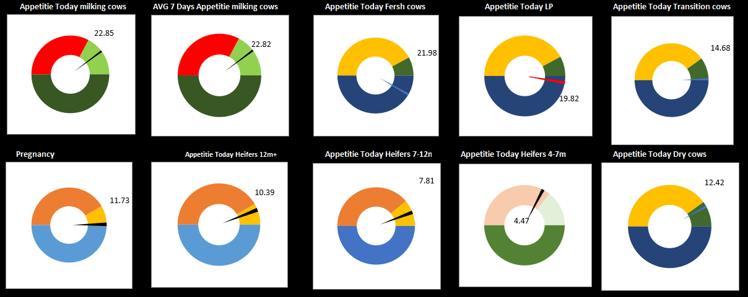
Using latest technologies & practices
Every Cow is monitored
Farm Management Software
Providing Alerts & Analytics

Slide 11
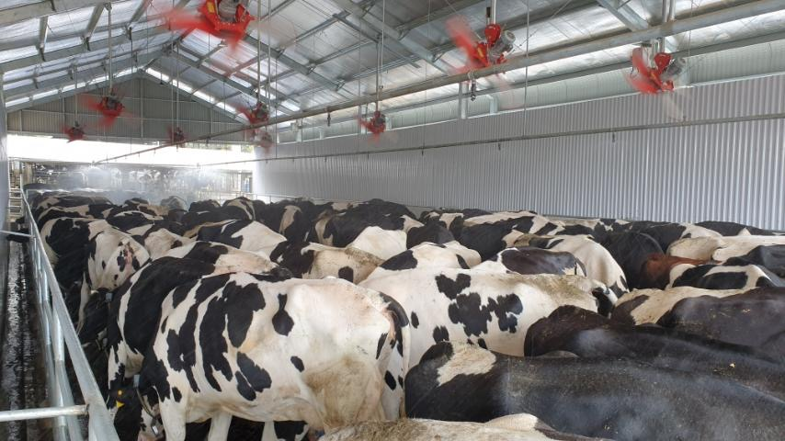

Heat Stress Handling & Advanced Farm Cooling methods
100 cows produce heat equal to 3,500 people
One cow in rest produce 3500w heat
One person in rest produce 100w heat

Slide 12
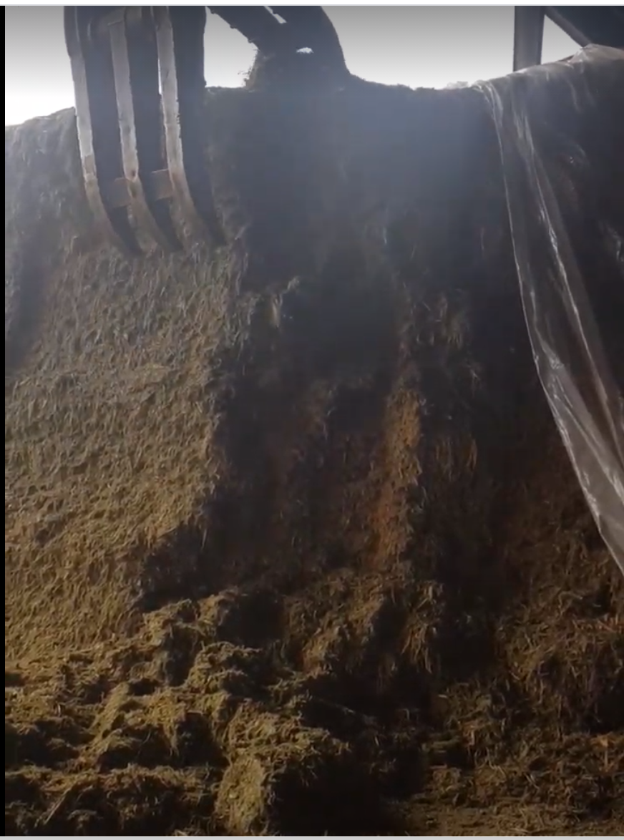
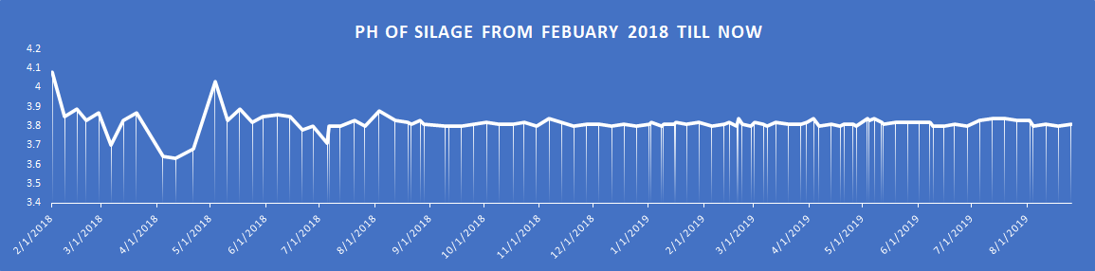
Using the silage
Checking DM two time per week
Checking PH two time per week ן
Take pictures of the face of the silage daily
Check with Pennsylvania Sieve Test once a week the ration.
Checking DMI of the cows.
Take out the silage from the bunker with minimum exposed to oxygen. bunker

Slide 13
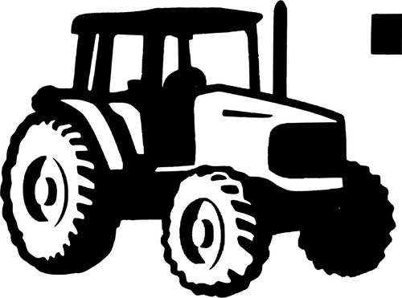

Our Community farm Model for Philippines
Planned Philippines Model Farm in Laguna
Knowledge Center
Health & Breed
Feed Center
Farm 1: Invest & Operate
Milk Collection
Manure Treatment
Farm 2: Invest & Operate
Farm 3: Invest & Operate
Shared Services & Facilities
Corn Farmers: grow & harvest

Slide 14
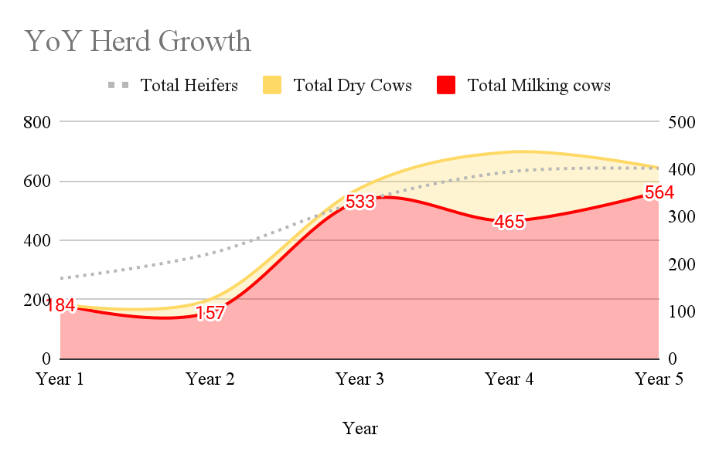
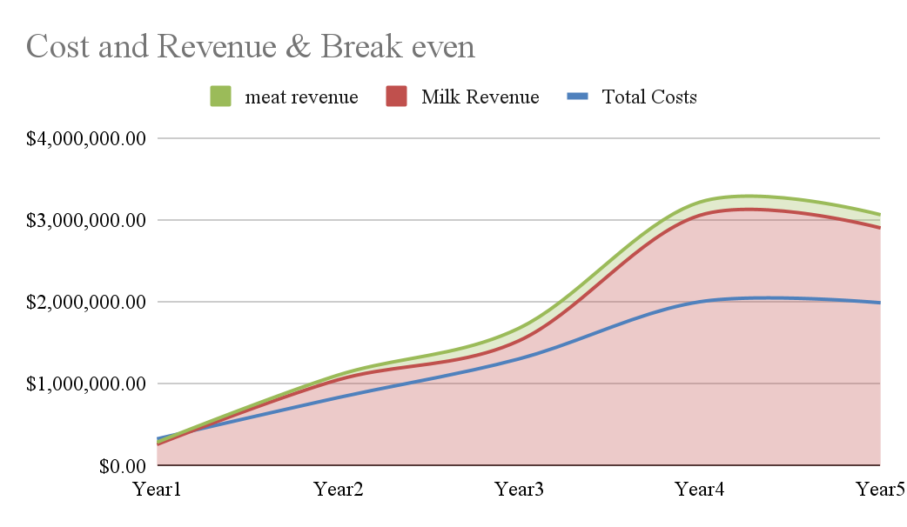
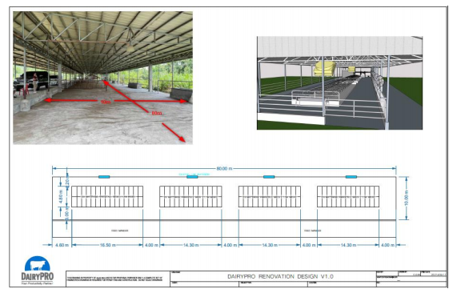
Our planned dairy farm in Philippines
1 year of detailed market & project planning
Turn existing farm in Laguna into high productivity farm
Local dairy experts
Break even OPEX from Y2

Slide 15
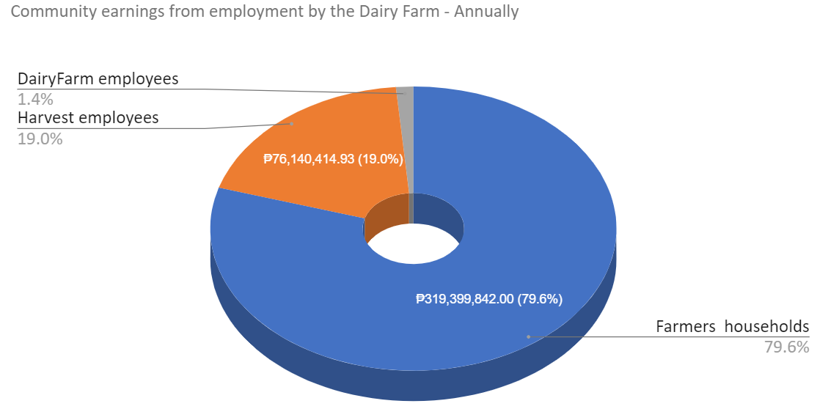
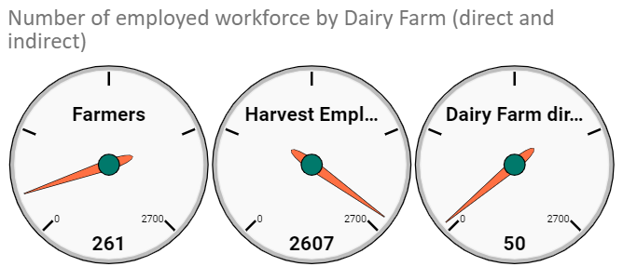
Supporting Philippines local community
generate jobs for local farmers
* Example based on 1200 cows in farm
* Harvest employees work ~73 days a year.

Slide 16
Thank you !
We are open to work with:
Existing Farms on consulting.
Investors, Landowners for our new farms
www.dairyfresh.asia
contact@dairyfresh.asia

Slide 17
Backup slides

Slide 18
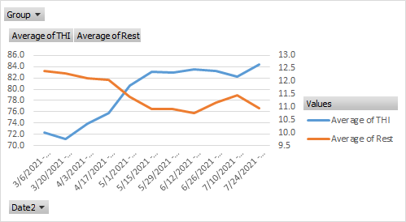
Avg Resting time(Hours per day)Compare to AVG THI
Correlation=-97

Slide 19
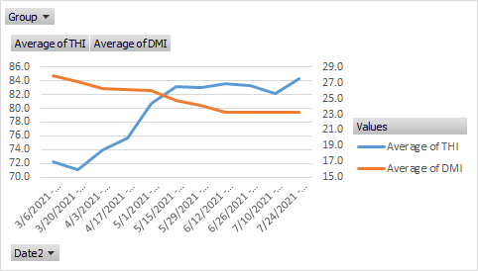
Avg DMI(Kg per day)Compare to AVG THI
Correlation=-91

Slide 20
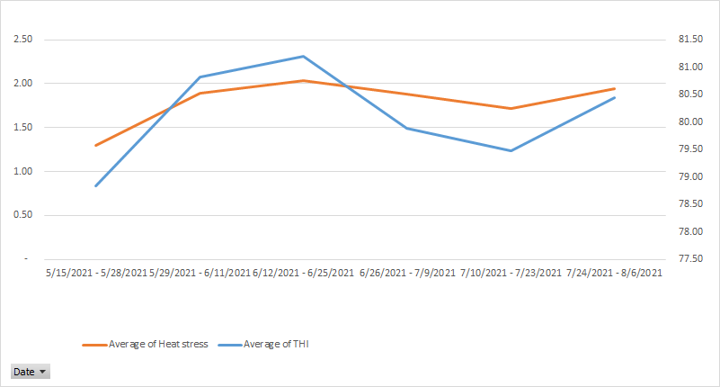
Avg Heat stress(Hours per day)Compare to AVG THI
Correlation=89

Slide 21
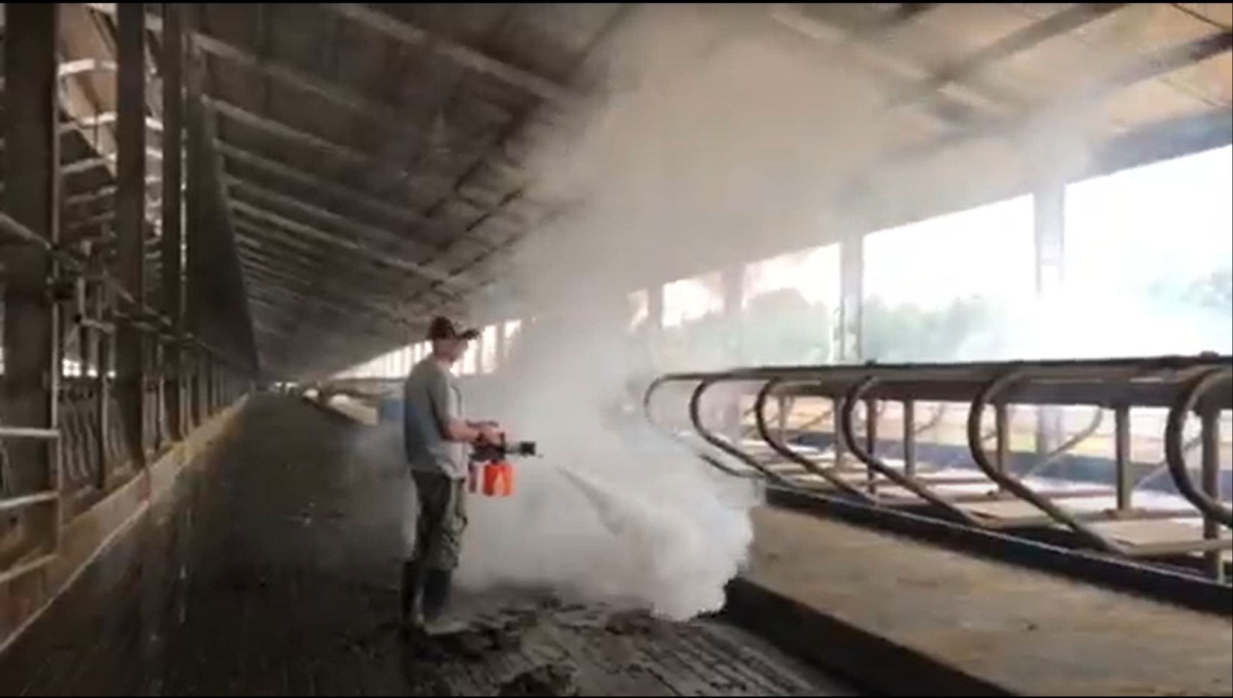
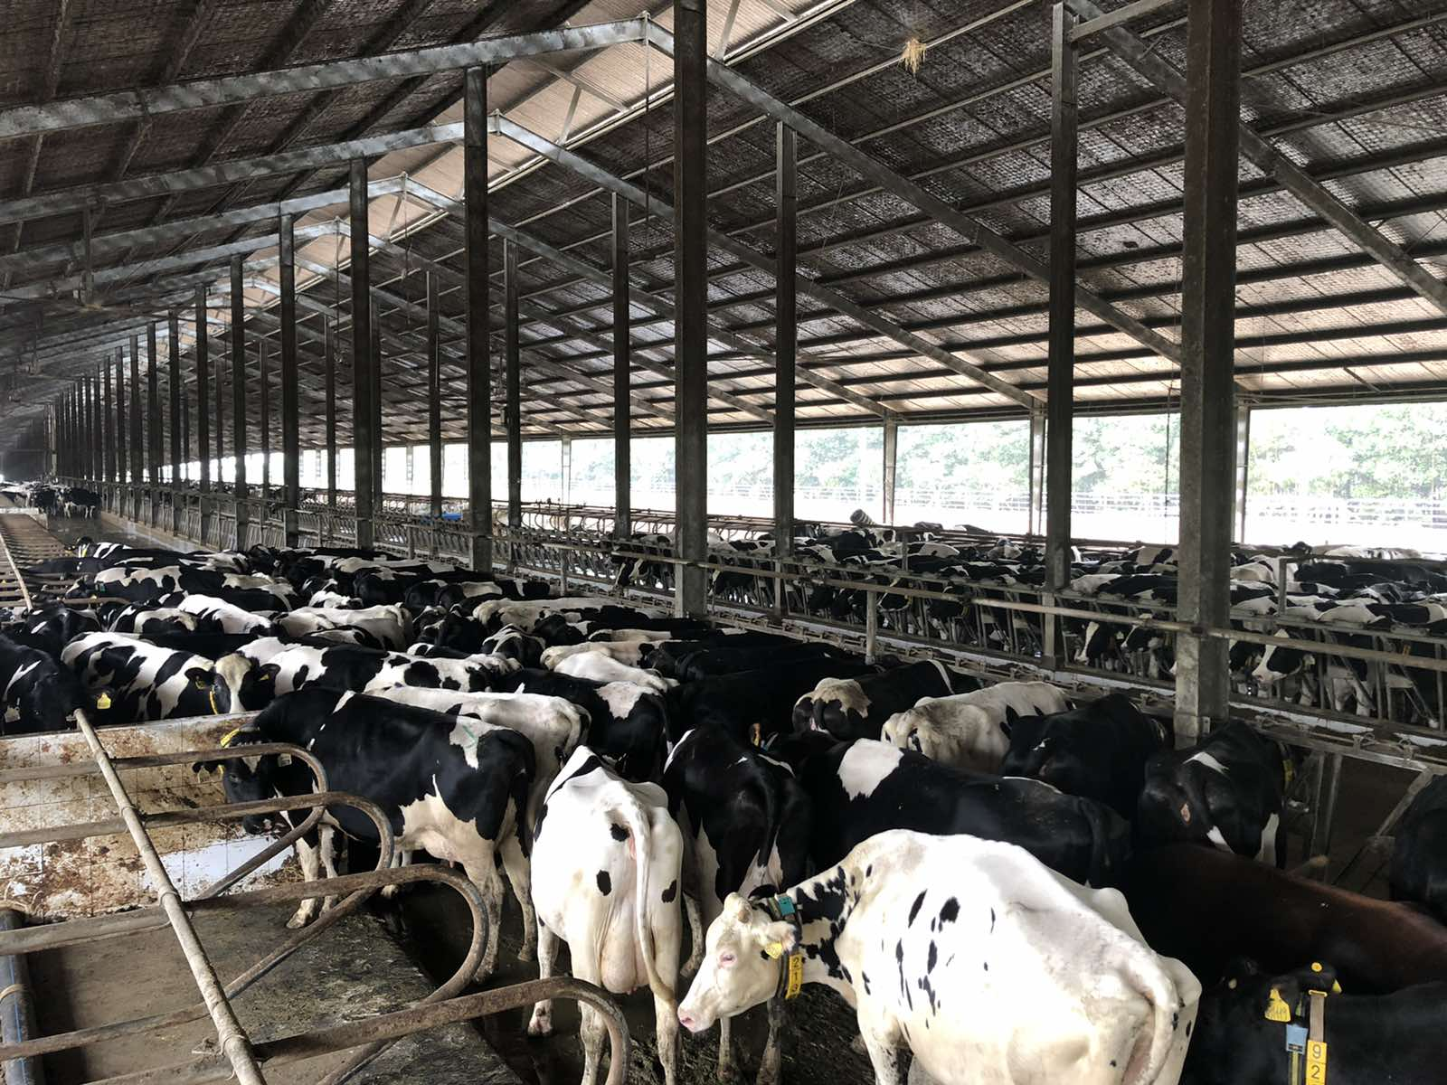
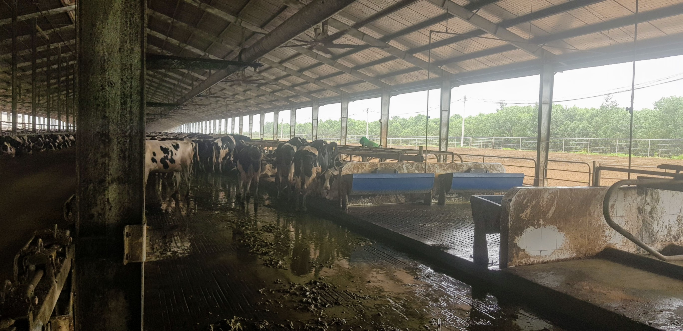
Managing crowding cows
Air Movement
Movie 1

Slide 22
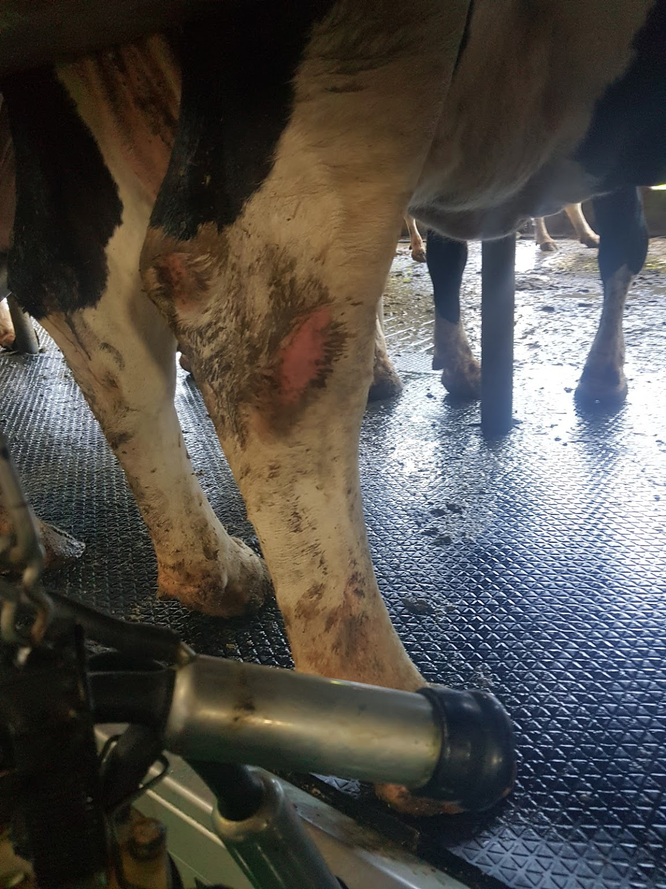
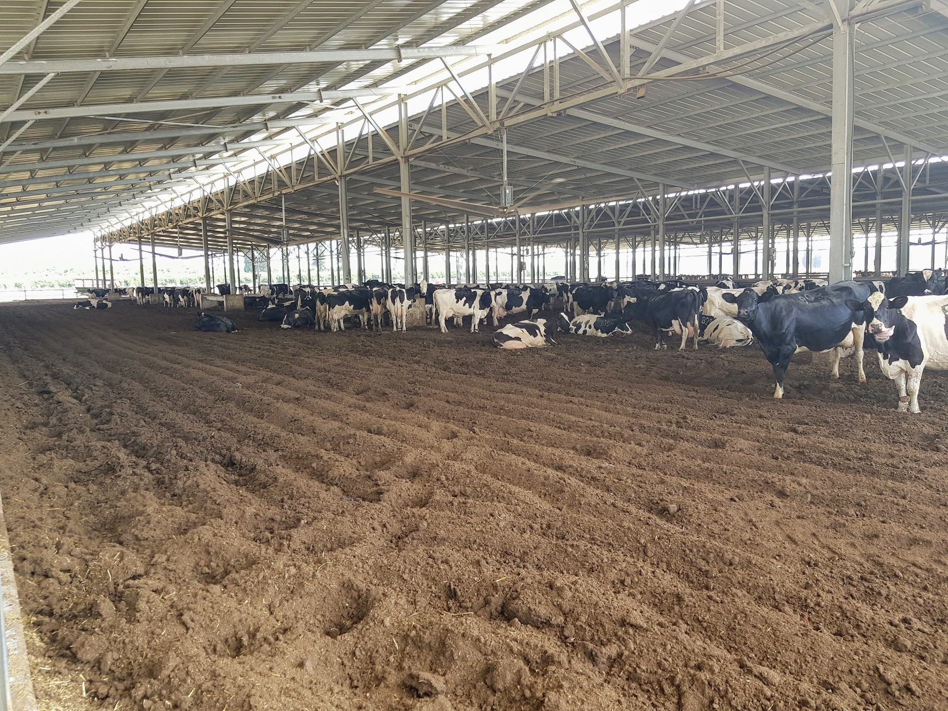
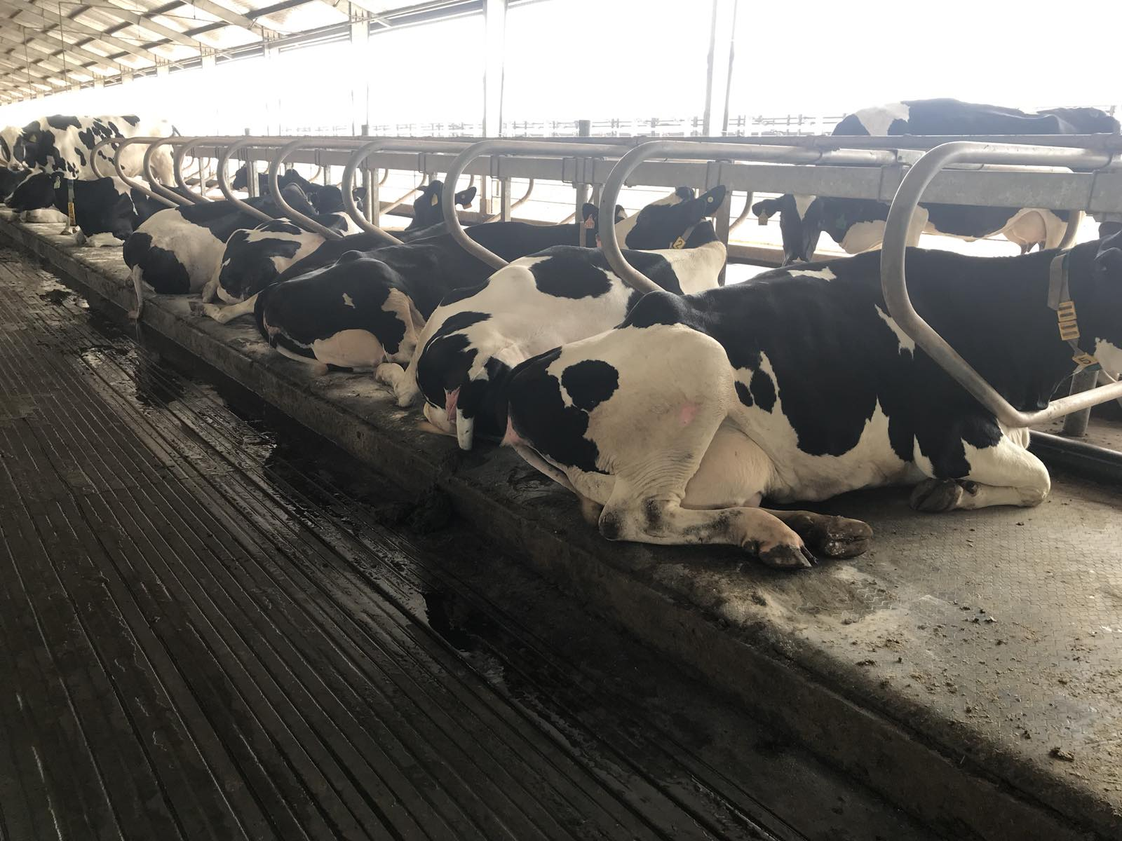
Cows Comforts, Resting & Milk Production
High level of cows comfort

Slide 23
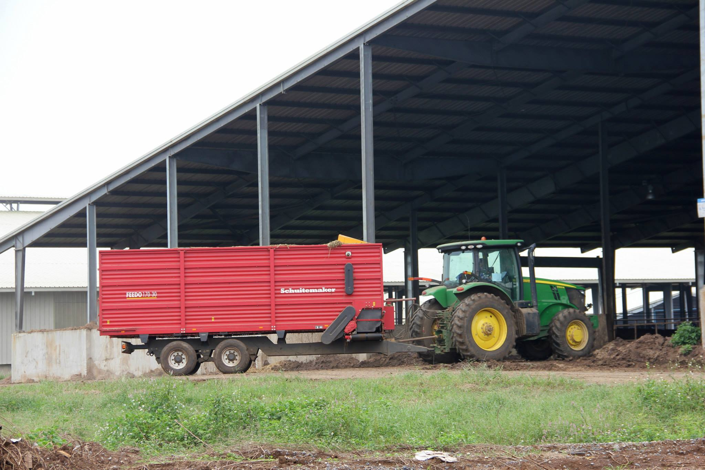
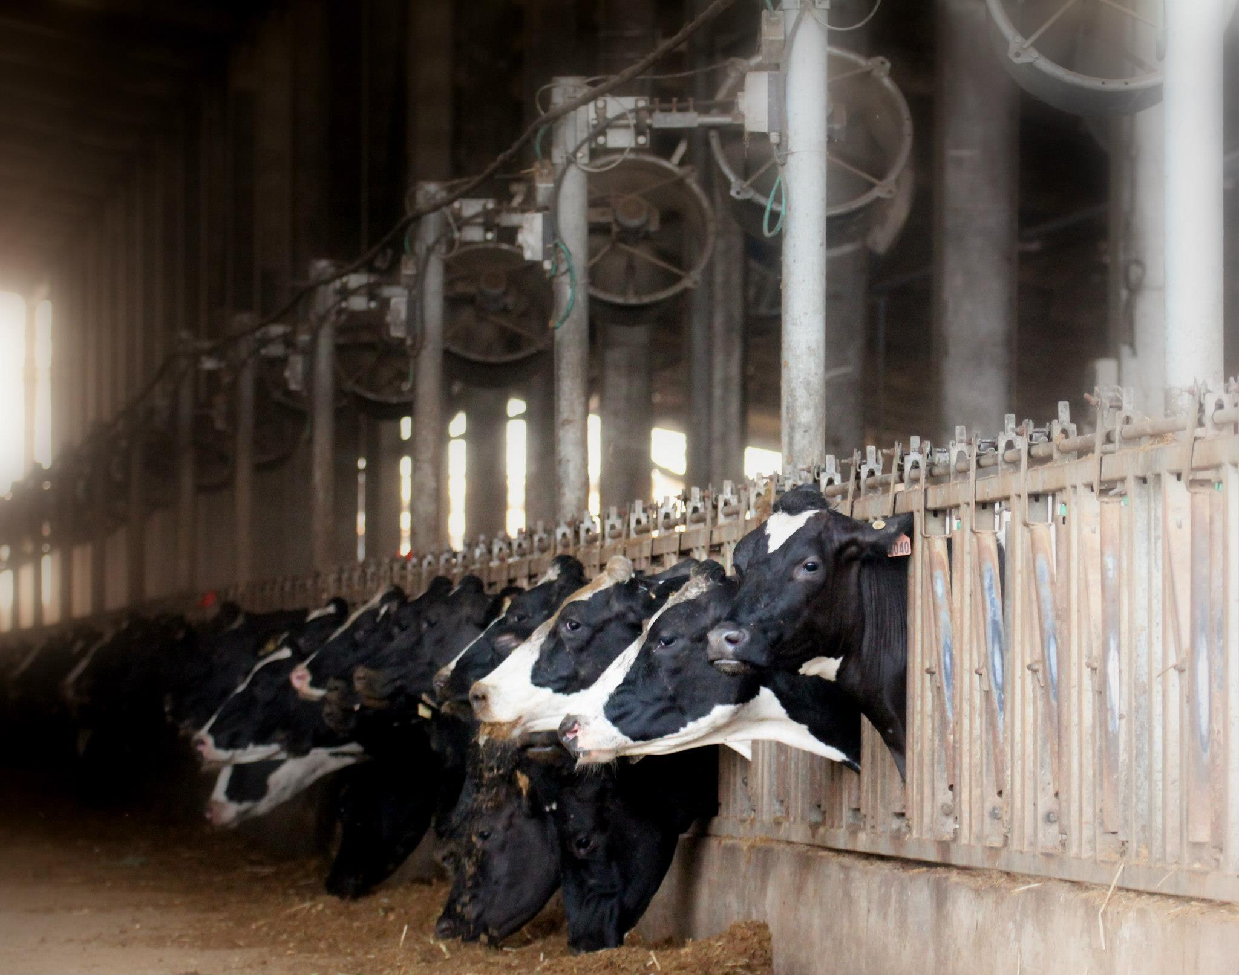
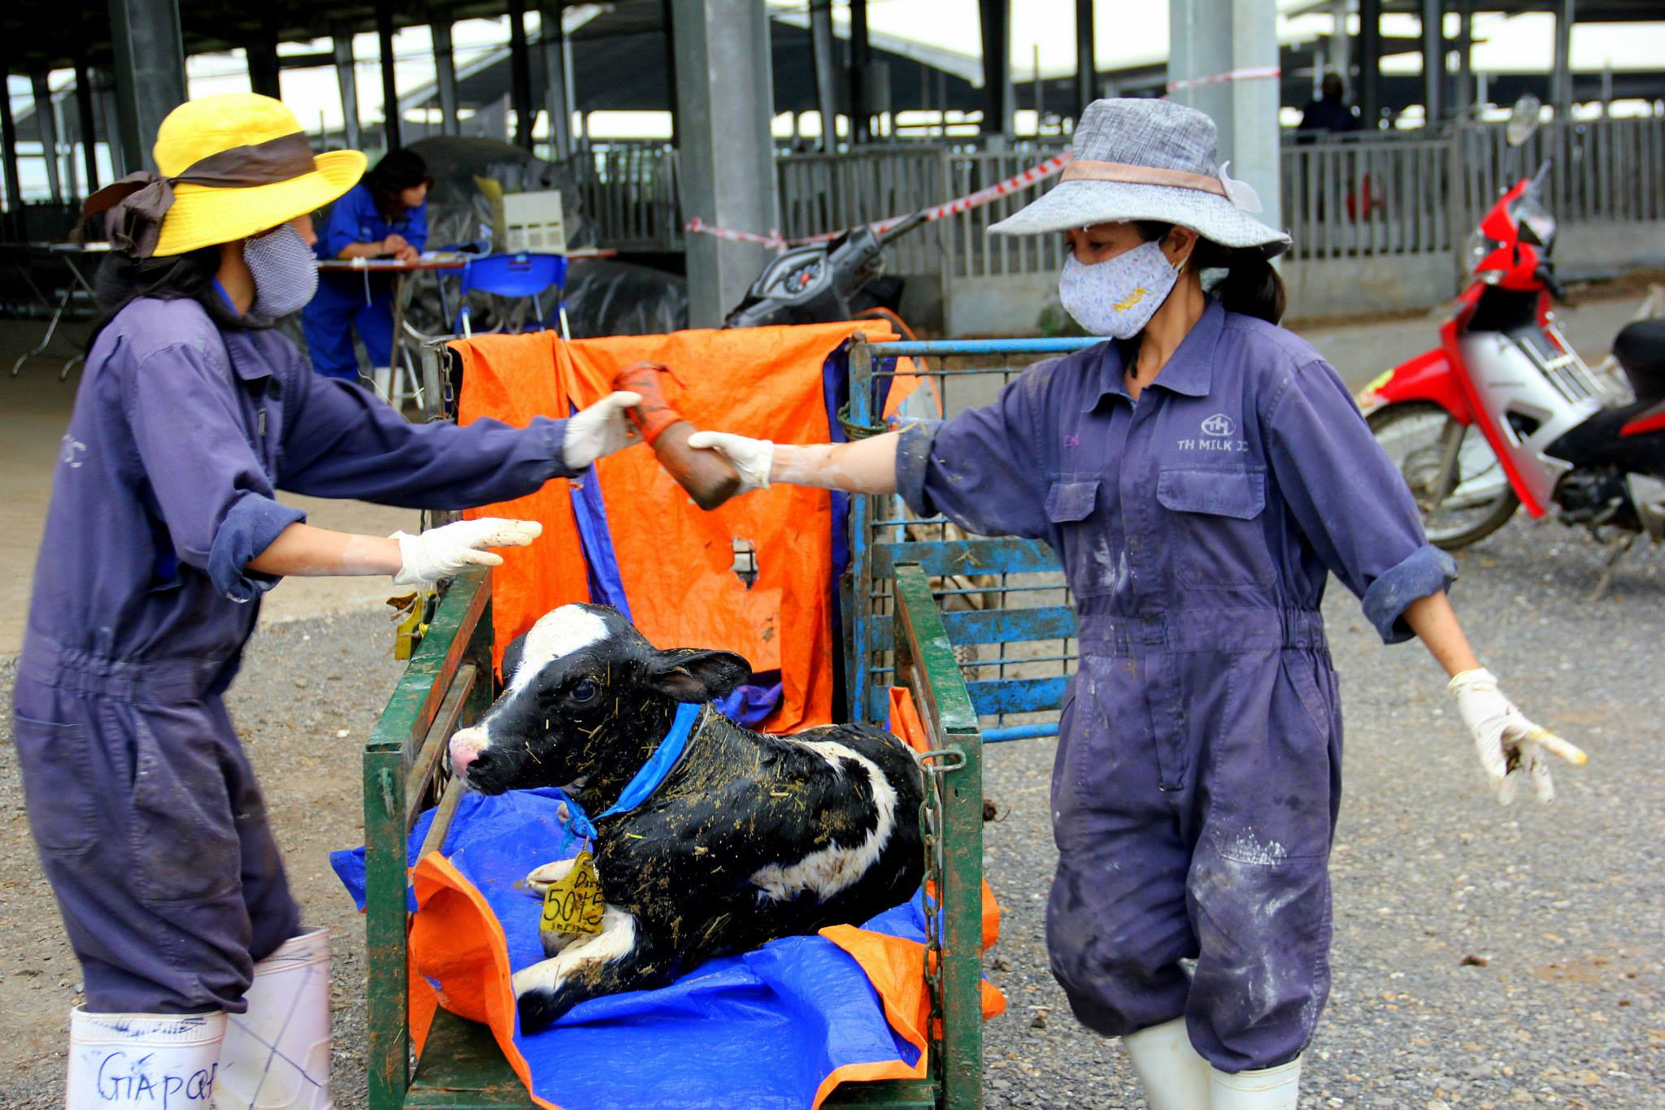
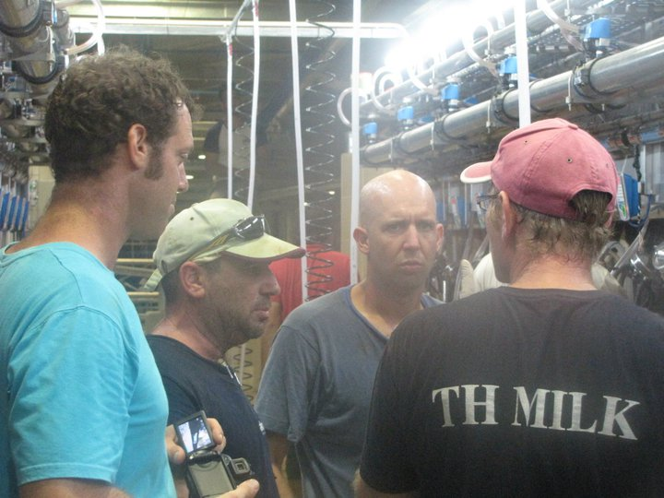
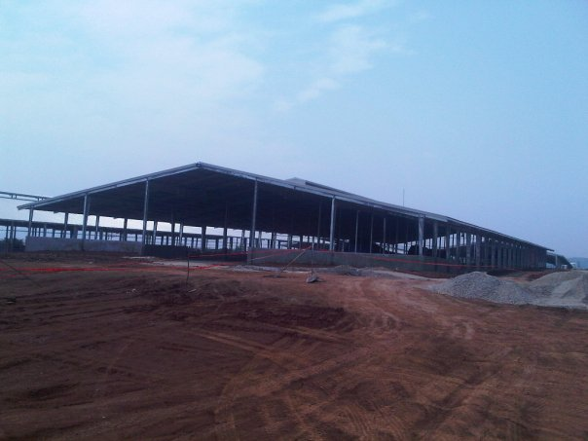
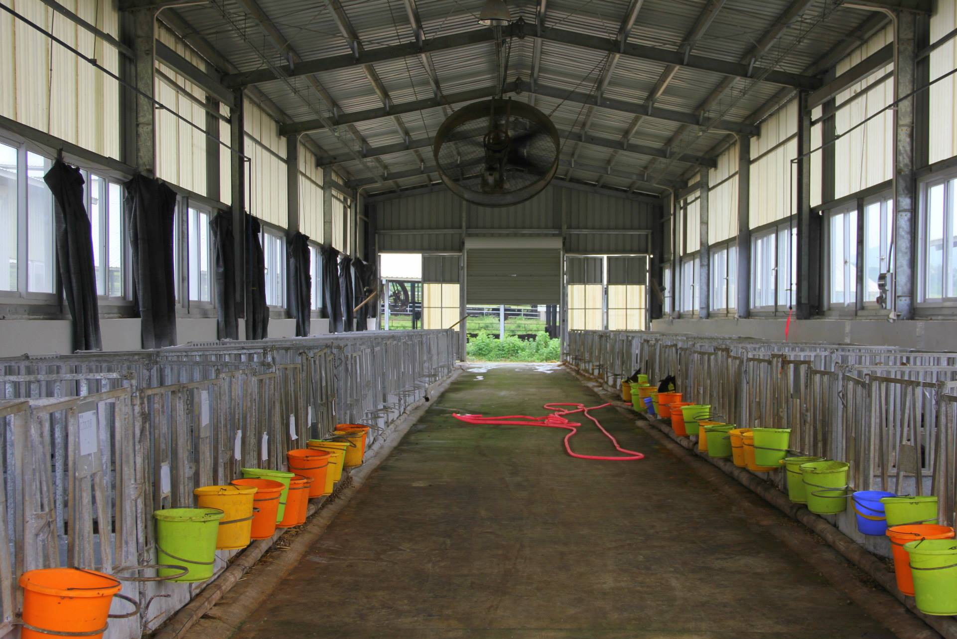
TH-True-Milk High Productivity Dairy Farm Construction 2010

