Slide 1
Worried about inflation?
Global Market Outlook
November 2021
Notes:
1

Slide 2
Why does inflation matter? Different scenarios result in very different outcomes
Central scenario remains pro-risk assets such as equities and high yield bonds
Central scenario: Inflation spike temporary and Fed looks through it
Implications: Economic outlook remains supportive as consumers continue to spend savings accumulated during the crisis, businesses rebuild inventories and monetary policy remains supportive. Emerging Market economies accelerate as vaccinations become more widely available. Likely positive for corporate earnings/cashflows and thus supportive of equity markets and sub-investment grade bonds.
Alternative scenario 1: Inflation spike temporary, but Fed moves to tight monetary policy stance
Implications: Fears of a recession increase and leads to significant deterioration in business confidence which is mirrored by risk assets. The severity of this depends on how quickly the Fed recognizes its mistake and reverses course, but equity markets falling by over 10% cannot be ruled out.
Alternative scenario 2: Inflation remains elevated, forcing Fed to tighten aggressively
Implications: Fed eventually recognizes its mistake in terms of losing control of inflation and tightens aggressively. In hitting the brakes, it overdoes the policy-tightening, sending the US economy into recession. Risk assets take a huge bath (>20% decline for equities), setting the foundation for the next bull market.

Slide 3
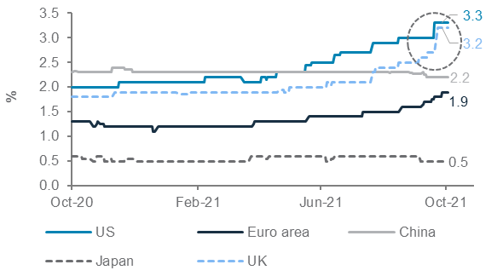
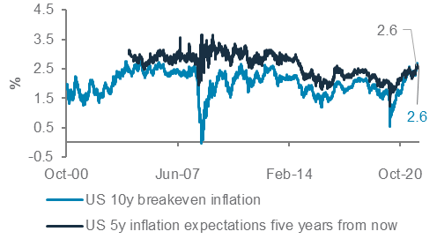
Near-term US inflation estimates higher, but long-term expectations remain within decade-long range
Supply and labour market constraints driving near-term inflation higher
Consensus inflation estimates for 2022; US market-based long-term inflation expectations
Source: Bloomberg, Standard Chartered

Slide 4
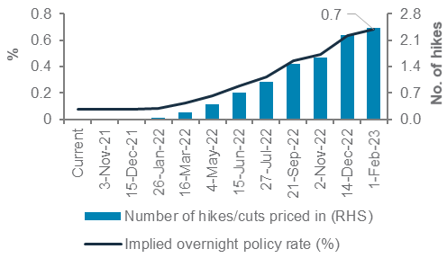
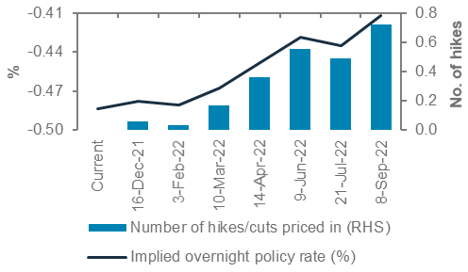
Fed, ECB rates likely to stay accommodative through 2022
The US policy rate remains well below the inflation rate, even when markets expect two Fed rates hikes by end-2022
Market-implied overnight Fed (left) and ECB (right) policy rates and number of rate hikes priced in
Source: Bloomberg, Standard Chartered

Slide 5
Risk assets to continue to benefit from the economic and earnings recovery.
Growth has historically been more important for equity outperformance than inflation
Average 12m returns in different economic regimes
Source: Bloomberg, Standard Chartered. Economic scenarios identified by BCA research across business cycles. Jun ‘21

Slide 6
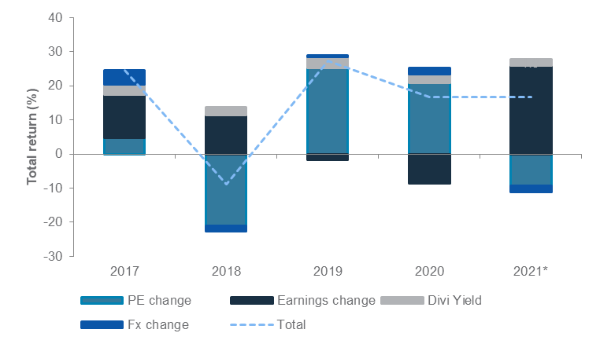
Global equities: Preferred on a 12-month time horizon, with earnings growth expected to remain the primary driver of returns
Earnings growth likely to be the primary driver of equity returns in 2021
Composition of returns in global equities
Source: MSCI, FactSet, Standard Chartered.; *2021 returns are year-to-date

Slide 7
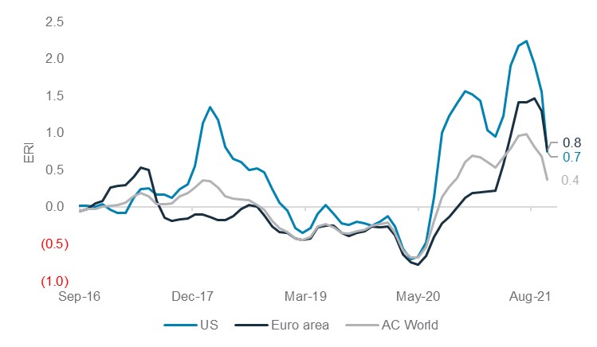
Euro area equities: Earnings revisions off their peak but remain at multi-year highs, supporting outperformance
Further fiscal stimulus in Germany could drive further earnings revisions
Earnings revision index* for Euro area, US and global equities
Source: FactSet, Standard Chartered. * Earnings revision index = 3 months moving average of (number of upgrades / number of downgrades – 1)

Slide 8
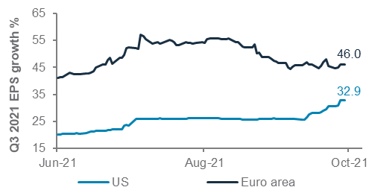
US equities: Boosted by strong Q3 earnings season
Agreement on infrastructure stimulus plan could unlock further upward revisions
Consensus Q3 2021 EPS growth forecasts for MSCI US and MSCI Euro area
Source: MSCI, FactSet, Standard Chartered

Slide 9
Our sector preferences

Slide 10
Asia USD bonds: Credit fundamentals remain strong
Share of High Yield bonds has reduced over the last 10 years
Bond rating weights of JP Morgan Asia Credit Index
Source: Bloomberg, Standard Chartered

Slide 11
FX: Inflation-adjusted rate differentials supports our bearish USD view
Real interest rate differentials suggest an eventual USD decline
USD index (DXY) chart with US-DXY 10Y real rate differentials* (RHS)
Source: Bloomberg, Standard Chartered
*Derived using 10-year government bond yields deflated by respective CPI indices (DXY-weighted)

Slide 12
Gold: Can help mitigate inflation risks
A weaker USD is a boon for gold; We also like the precious metal for its inflation hedge characteristics
Gold (USD/oz), DXY (RHS, inverted)
Source: Bloomberg, Standard Chartered

Slide 13
Our asset class views at a glance
Equities | ▲
Euro Area | ▲
US | ▲
Asia ex-Japan | ◆
Japan | ◆
UK | ◆
Bonds (Rates) | ▼
Govt EM local | ◆
Govt DM IG | ▼
Bonds (Credit) | ◆
Corp DM HY | ▲
Asia USD | ▲
Govt EM USD | ▲
Corp DM IG | ▼
Alternative Strategies | ◆
Equity hedge | ▲
Event-driven | ◆
Global macro | ◆
Relative Value | ▼
Cash | ▼
USD | ▼
AUD | ▲
NZD | ▲
EUR | ▲
GBP | ◆
CAD | ◆
CNY | ◆
JPY | ◆
Gold | ▲
Legend: | ▲ | Most preferred | | ▼ | Less preferred | | ◆ | Core holding
Green/Red indicates an Up/Downgrade from last month
Notes:
UPDATE SLIDE

Slide 14
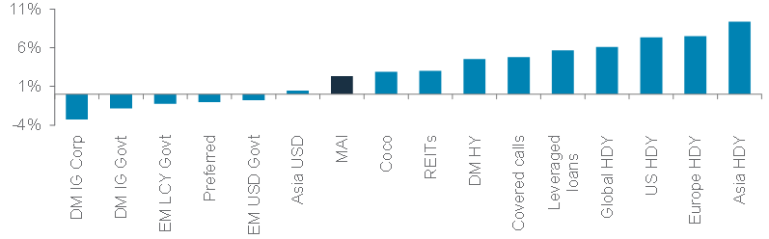



Multi-asset income – Maintain conviction in Europe high dividend equities. Tactically add exposure to DM HY, leveraged loans and hybrids
Tapering is not an immediate risk for a diversified income allocation
Average total returns in periods when the 10-year US Treasury yield was rising and the Fed policy rate was flat or rising, during 2005 – 2021
Source: Bloomberg, Standard Chartered

Slide 15
Multi-Asset Income Allocation
22% Non-core
42% Bond
8% - Covered calls
11%- Sub financials
3% - Others
DM IG Govt - 2%
DM IG Corp - 2%
DM HY Corp and Senior Floating rate loans - 15%
EM HC Govt - 9%
EM LC Govt - 3%
Asia USD Corp - 8%
Asia HY Corp - 3%
36% Equity
29% - Global HDY
8% - Europe HDY
Source: Standard Chartered Global Investment Committee
Notes:
A quick overview of our views is as follows.
One, we expect equities to continue to grind higher
Two we expect higher yielding US dollar bonds to outperform against the backdrop of an intense search for income
Three, we continue to expect the US dollar to weaken
And four, we believe investors can manage the risks in different ways using gold, derivative strategies and some of the structural themes ,such as sustainable investing, to mitigate risks.

Slide 16

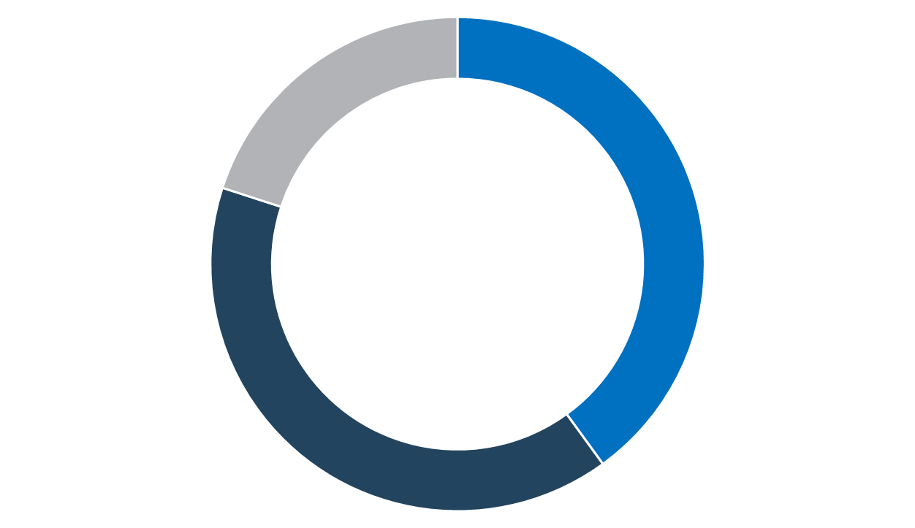







Future proofing your investments
Alternative Energy
Wind
Low yield Environment
World of Yield-Free Risk
Solar
Long term Themes
Time for Climate Investing
Water
Disruptive Innovation
5G/Internet of Things (IoT)
Fintech
Electric Vehicles

Slide 17
Explanatory Notes
1. The figures on slide 15 show allocations for a moderate risk profile only – different risk profiles may produce significantly different asset allocation results. Slide 15 is only an example, provided for general information only and they do not constitute investment advice, an offer, recommendation or solicitation. They do not take into account the specific investment objectives, needs or risk tolerances of a particular person or class of persons and they have not been prepared for any particular person or class of persons.
2. Contingent Convertibles are complex financial instruments and are not a suitable or appropriate investment for all investors. This document is not an offer to sell or an invitation to buy any securities or any beneficial interests therein. Contingent convertible securities are not intended to be sold and should not be sold to retail clients in the European Economic Area (EEA) (each as defined in the Policy Statement on the Restrictions on the Retail Distribution of Regulatory Capital Instruments (Feedback to CP14/23 and Final Rules) (“Policy Statement”), read together with the Product Intervention (Contingent Convertible Instruments and Mutual Society Shares) Instrument 2015 (“Instrument”, and together with the Policy Statement, the “Permanent Marketing Restrictions”), which were published by the United Kingdom’s Financial Conduct Authority in June 2015), other than in circumstances that do not give rise to a contravention of the Permanent Marketing Restrictions

Slide 18
Disclosures
This document is confidential and may also be privileged. If you are not the intended recipient, please destroy all copies and notify the sender immediately. This document is being distributed for general information only and is subject to the relevant disclaimers available at https:// www. sc. com/en/regulatory-disclosures/#market-commentary-disclaimer. It is not and does not constitute research material, independent research, an offer, recommendation or solicitation to enter into any transaction or adopt any hedging, trading or investment strategy, in relation to any securities or other financial instruments. This document is for general evaluation only. It does not take into account the specific investment objectives, financial situation or particular needs of any particular person or class of persons and it has not been prepared for any particular person or class of persons. You should not rely on any contents of this document in making any investment decisions. Before making any investment, you should carefully read the relevant offering documents and seek independent legal, tax and regulatory advice. In particular, we recommend you to seek advice regarding the suitability of the investment product, taking into account your specific investment objectives, financial situation or particular needs, before you make a commitment to purchase the investment product. Opinions, projections and estimates are solely those of SCB at the date of this document and subject to change without notice. Past performance is not indicative of future results and no representation or warranty is made regarding future performance. Any forecast contained herein as to likely future movements in rates or prices or likely future events or occurrences constitutes an opinion only and is not indicative of actual future movements in rates or prices or actual future events or occurrences (as the case may be). This document must not be forwarded or otherwise made available to any other person without the express written consent of the Standard Chartered Group (as defined below). Standard Chartered Bank is incorporated in England with limited liability by Royal Charter 1853 Reference Number ZC18. The Principal Office of the Company is situated in England at 1 Basinghall Avenue, London, EC2V 5DD. Standard Chartered Bank is authorised by the Prudential Regulation Authority and regulated by the Financial Conduct Authority and Prudential Regulation Authority. Standard Chartered PLC, the ultimate parent company of Standard Chartered Bank, together with its subsidiaries and affiliates (including each branch or representative office), form the Standard Chartered Group. Standard Chartered Private Bank is the private banking division of Standard Chartered. Private banking activities may be carried out internationally by different legal entities and affiliates within the Standard Chartered Group (each an “SC Group Entity”) according to local regulatory requirements. Not all products and services are provided by all branches, subsidiaries and affiliates within the Standard Chartered Group. Some of the SC Group Entities only act as representatives of Standard Chartered Private Bank and may not be able to offer products and services or offer advice to clients. #ESG data has been provided by Sustainalytics. Refer to https://www.sustainalytics.com/esg-data for more information.
Copyright © 2021, Accounting Research & Analytics, LLC d/b/a CFRA (and its affiliates, as applicable). Reproduction of content provided by CFRA in any form is prohibited except with the prior written permission of CFRA. CFRA content is not investment advice and a reference to or observation concerning a security or investment provided in the CFRA SERVICES is not a recommendation to buy, sell or hold such investment or security or make any other investment decisions. The CFRA content contains opinions of CFRA based upon publicly-available information that CFRA believes to be reliable and the opinions are subject to change without notice. This analysis has not been submitted to, nor received approval from, the United States Securities and Exchange Commission or any other regulatory body. While CFRA exercised due care in compiling this analysis, CFRA, ITS THIRD-PARTY SUPPLIERS, AND ALL RELATED ENTITIES SPECIFICALLY DISCLAIM ALL WARRANTIES, EXPRESS OR IMPLIED, INCLUDING, BUT NOT LIMITED TO, ANY WARRANTIES OF MERCHANTABILITY OR FITNESS FOR A PARTICULAR PURPOSE OR USE, to the full extent permitted by law, regarding the accuracy, completeness, or usefulness of this information and assumes no liability with respect to the consequences of relying on this information for investment or other purposes. No content provided by CFRA (including ratings, credit-related analyses and data, valuations, model, software or other application or output therefrom) or any part thereof may be modified, reverse engineered, reproduced or distributed in any form by any means, or stored in a database or retrieval system, without the prior written permission of CFRA, and such content shall not be used for any unlawful or unauthorized purposes. CFRA and any third-party providers, as well as their directors, officers, shareholders, employees or agents do not guarantee the accuracy, completeness, timeliness or availability of such content. In no event shall CFRA, its affiliates, or their third-party suppliers be liable for any direct, indirect, special, or consequential damages, costs, expenses, legal fees, or losses (including lost income or lost profit and opportunity costs) in connection with a subscriber’s, subscriber’s customer’s, or other’s use of CFRA’s content.

Slide 19
Disclosures
Market Abuse Regulation (MAR) Disclaimer
Banking activities may be carried out internationally by different branches, subsidiaries and affiliates within the Standard Chartered Group according to local regulatory requirements. Opinions may contain outright “buy”, “sell”, “hold” or other opinions. The time horizon of this opinion is dependent on prevailing market conditions and there is no planned frequency for updates to the opinion. This opinion is not independent of Standard Chartered Group’s trading strategies or positions. Standard Chartered Group and/or its affiliates or its respective officers, directors, employee benefit programmes or employees, including persons involved in the preparation or issuance of this document may at any time, to the extent permitted by applicable law and/or regulation, be long or short any securities or financial instruments referred to in this document or have material interest in any such securities or related investments. Therefore, it is possible, and you should assume, that Standard Chartered Group has a material interest in one or more of the financial instruments mentioned herein. Please refer to https://www.sc. com/en/banking-services/market-disclaimer.html for more detailed disclosures, including past opinions/ recommendations in the last 12 months and conflict of interests, as well as disclaimers. A covering strategist may have a financial interest in the debt or equity securities of this company/issuer. This document must not be forwarded or otherwise made available to any other person without the express written consent of Standard Chartered Group.
Country/Market Specific Disclosures
Botswana: This document is being distributed in Botswana by, and is attributable to, Standard Chartered Bank Botswana Limited which is a financial institution licensed under the Section 6 of the Banking Act CAP 46.04 and is listed in the Botswana Stock Exchange. Brunei Darussalam: This document is being distributed in Brunei Darussalam by, and is attributable to, Standard Chartered Bank (Brunei Branch) | Registration Number RFC/61. Standard Chartered Bank is incorporated in England with limited liability by Royal Charter 1853 Reference Number ZC18 and Standard Chartered Securities (B) Sdn Bhd, which is a limited liability company registered with the Registry of Companies with Registration Number RC20001003 and licensed by Autoriti Monetari Brunei Darussalam as a Capital Markets Service License Holder with License Number AMBD/R/CMU/S3-CL. China Mainland: This document is being distributed in China by, and is attributable to, Standard Chartered Bank (China) Limited which is mainly regulated by China Banking and Insurance Regulatory Commission (CBIRC), State Administration of Foreign Exchange (SAFE), and People’s Bank of China (PBOC). Hong Kong: In Hong Kong, this document, except for any portion advising on or facilitating any decision on futures contracts trading, is distributed by Standard Chartered Bank (Hong Kong) Limited (“SCBHK”), a subsidiary of Standard Chartered PLC. SCBHK has its registered address at 32/F, Standard Chartered Bank Building, 4-4A Des Voeux Road Central, Hong Kong and is regulated by the Hong Kong Monetary Authority and registered with the Securities and Futures Commission (“SFC”) to carry on Type 1 (dealing in securities), Type 4 (advising on securities), Type 6 (advising on corporate finance) and Type 9 (asset management) regulated activity under the Securities and Futures Ordinance (Cap. 571) (“SFO”) (CE No. AJI614). The contents of this document have not been reviewed by any regulatory authority in Hong Kong and you are advised to exercise caution in relation to any offer set out herein. If you are in doubt about any of the contents of this document, you should obtain independent professional advice. Any product named herein may not be offered or sold in Hong Kong by means of any document at any time other than to “professional investors” as defined in the SFO and any rules made under that ordinance. In addition, this document may not be issued or possessed for the purposes of issue, whether in Hong Kong or elsewhere, and any interests may not be disposed of, to any person unless such person is outside Hong Kong or is a “professional investor” as defined in the SFO and any rules made under that ordinance, or as otherwise may be permitted by that ordinance. In Hong Kong, Standard Chartered Private Bank is the private banking division of Standard Chartered Bank (Hong Kong) Limited.

Slide 20
Disclosures
Ghana: Standard Chartered Bank Ghana PLC accepts no liability and will not be liable for any loss or damage arising directly or indirectly (including special, incidental or consequential loss or damage) from your use of these documents. Past performance is not indicative of future results and no representation or warranty is made regarding future performance. You should seek advice from a financial adviser on the suitability of an investment for you, taking into account these factors before making a commitment to invest in an investment. To unsubscribe from receiving further updates, please click here. Please do not reply to this email. Call our Priority Banking on 0302610750 for any questions or service queries. You are advised not to send any confidential and/or important information to the Bank via e-mail, as the Bank makes no representations or warranties as to the security or accuracy of any information transmitted via e-mail. The Bank shall not be responsible for any loss or damage suffered by you arising from your decision to use e-mail to communicate with the Bank. India: This document is being distributed in India by Standard Chartered Bank in its capacity as a distributor of mutual funds and referrer of any other third-party financial products. Standard Chartered Bank does not offer any ‘Investment Advice’ as defined in the Securities and Exchange Board of India (Investment Advisers) Regulations, 2013 or otherwise. Services/products related securities business offered by Standard Charted Bank are not intended for any person, who is a resident of any jurisdiction, the laws of which imposes prohibition on soliciting the securities business in that jurisdiction without going through the registration requirements and/or prohibit the use of any information contained in this document. Indonesia: This document is being distributed in Indonesia by Standard Chartered Bank, Indonesia branch, which is a financial institution licensed, registered and supervised by Otoritas Jasa Keuangan (Financial Service Authority). Jersey: The Jersey Branch of Standard Chartered Bank is regulated by the Jersey Financial Services Commission. Copies of the latest audited accounts of Standard Chartered Bank are available from its principal place of business in Jersey: PO Box 80, 15 Castle Street, St Helier, Jersey JE4 8PT. Standard Chartered Bank is incorporated in England with limited liability by Royal Charter in 1853 Reference Number ZC 18. The Principal Office of the Company is situated in England at 1 Basinghall Avenue, London, EC2V 5DD. Standard Chartered Bank is authorised by the Prudential Regulation Authority and regulated by the Financial Conduct Authority and Prudential Regulation Authority. The Jersey Branch of Standard Chartered Bank is also an authorised financial services provider under license number 44946 issued by the Financial Sector Conduct Authority of the Republic of South Africa. Jersey is not part of the United Kingdom and all business transacted with Standard Chartered Bank, Jersey Branch and other SC Group Entity outside of the United Kingdom, are not subject to some or any of the investor protection and compensation schemes available under United Kingdom law. Kenya: This document is being distributed in Kenya by, and is attributable to Standard Chartered Bank Kenya Limited. Investment Products and Services are distributed by Standard Chartered Investment Services Limited, a wholly owned subsidiary of Standard Chartered Bank Kenya Limited (Standard Chartered Bank/the Bank) that is licensed by the Capital Markets Authority as a Fund Manager. Standard Chartered Bank Kenya Limited is regulated by the Central Bank of Kenya. Malaysia: This document is being distributed in Malaysia by Standard Chartered Bank Malaysia Berhad. Recipients in Malaysia should contact Standard Chartered Bank Malaysia Berhad in relation to any matters arising from, or in connection with, this document. Nigeria: This document is being distributed in Nigeria by Standard Chartered Bank Nigeria Limited (“the Bank”), a bank duly licensed and regulated by the Central Bank of Nigeria. The Bank accepts no liability for any loss or damage arising directly or indirectly (including special, incidental or consequential loss or damage) from your use of these documents. You should seek advice from a financial adviser on the suitability of an investment for you, taking into account these factors before making a commitment to invest in an investment. To unsubscribe from receiving further updates, please click the link at the bottom of this email or send an email to clientcare.ng@sc.com requesting to be removed from our mailing list. Please do not reply to this email. Call our Priority Banking on 01-2772514 for any questions or service queries. The Bank shall not be responsible for any loss or damage arising from your decision to send confidential and/or important information to the Bank via e-mail, as the Bank makes no representations or warranties as to the security or accuracy of any information transmitted via e-mail.

Slide 21
Disclosures
Pakistan: This document is being distributed in Pakistan by, and attributable to Standard Chartered Bank (Pakistan) Limited having its registered office at PO Box 5556, I.I Chundrigar Road Karachi, which is a banking company registered with State Bank of Pakistan under Banking Companies Ordinance 1962 and is also having licensed issued by Securities & Exchange Commission of Pakistan for Security Advisors. Standard Chartered Bank (Pakistan) Limited acts as a distributor of mutual funds and referrer of other third-party financial products. Singapore: This document is being distributed in Singapore by, and is attributable to, Standard Chartered Bank (Singapore) Limited (Registration No. 201224747C/ GST Group Registration No. MR-8500053-0, “SCBSL”). Recipients in Singapore should contact SCBSL in relation to any matters arising from, or in connection with, this document. SCBSL is an indirect wholly owned subsidiary of Standard Chartered Bank and is licensed to conduct banking business in Singapore under the Singapore Banking Act, Chapter 19. Standard Chartered Private Bank is the private banking division of SCBSL. IN RELATION TO ANY SECURITY OR SECURITIES-BASED DERIVATIVES CONTRACT REFERRED TO IN THIS DOCUMENT, THIS DOCUMENT, TOGETHER WITH THE ISSUER DOCUMENTATION, SHALL BE DEEMED AN INFORMATION MEMORANDUM (AS DEFINED IN SECTION 275 OF THE SECURITIES AND FUTURES ACT, CHAPTER 289 (“SFA”)). THIS DOCUMENT IS INTENDED FOR DISTRIBUTION TO ACCREDITED INVESTORS, AS DEFINED IN SECTION 4A(1)(a) OF THE SFA, OR ON THE BASIS THAT THE SECURITY OR SECURITIES-BASED DERIVATIVES CONTRACT MAY ONLY BE ACQUIRED AT A CONSIDERATION OF NOT LESS THAN S$200,000 (OR ITS EQUIVALENT IN A FOREIGN CURRENCY) FOR EACH TRANSACTION. Further, in relation to any security or securities-based derivatives contract, neither this document nor the Issuer Documentation has been registered as a prospectus with the Monetary Authority of Singapore under the SFA. Accordingly, this document and any other document or material in connection with the offer or sale, or invitation for subscription or purchase, of the product may not be circulated or distributed, nor may the product be offered or sold, or be made the subject of an invitation for subscription or purchase, whether directly or indirectly, to persons other than a relevant person pursuant to section 275(1) of the SFA, or any person pursuant to section 275(1A) of the SFA, and in accordance with the conditions specified in section 275 of the SFA, or pursuant to, and in accordance with the conditions of, any other applicable provision of the SFA. In relation to any collective investment schemes referred to in this document, this document is for general information purposes only and is not an offering document or prospectus (as defined in the SFA). This document is not, nor is it intended to be (i) an offer or solicitation of an offer to buy or sell any capital markets product; or (ii) an advertisement of an offer or intended offer of any capital markets product. Deposit Insurance Scheme: Singapore dollar deposits of non-bank depositors are insured by the Singapore Deposit Insurance Corporation, for up to S$75,000 in aggregate per depositor per Scheme member by law. Foreign currency deposits, dual currency investments, structured deposits and other investment products are not insured. This advertisement has not been reviewed by the Monetary Authority of Singapore. Taiwan: Standard Chartered Bank (“SCB”) or Standard Chartered Bank (Taiwan) Limited (“SCB (Taiwan)”) may be involved in the financial instruments contained herein or other related financial instruments. The author of this document may have discussed the information contained herein with other employees or agents of SCB or SCB (Taiwan). The author and the above-mentioned employees of SCB or SCB (Taiwan) may have taken related actions in respect of the information involved (including communication with customers of SCB or SCB (Taiwan) as to the information contained herein). The opinions contained in this document may change, or differ from the opinions of employees of SCB or SCB (Taiwan). SCB and SCB (Taiwan) will not provide any notice of any changes to or differences between the above-mentioned opinions. This document may cover companies with which SCB or SCB (Taiwan) seeks to do business at times and issuers of financial instruments. Therefore, investors should understand that the information contained herein may serve as specific purposes as a result of conflict of interests of SCB or SCB (Taiwan). SCB, SCB (Taiwan), the employees (including those who have discussions with the author) or customers of SCB or SCB (Taiwan) may have an interest in the products, related financial instruments or related derivative financial products contained herein; invest in those products at various prices and on different market conditions; have different or conflicting interests in those products. The potential impacts include market makers’ related activities, such as dealing, investment, acting as agents, or performing financial or consulting services in relation to any of the products referred to in this document.

Slide 22
Disclosures
UAE: DIFC - Standard Chartered Bank is incorporated in England with limited liability by Royal Charter 1853 Reference Number ZC18.The Principal Office of the Company is situated in England at 1 Basinghall Avenue, London, EC2V 5DD. Standard Chartered Bank is authorised by the Prudential Regulation Authority and regulated by the Financial Conduct Authority and Prudential Regulation Authority. Standard Chartered Bank, Dubai International Financial Centre having its offices at Dubai International Financial Centre, Building 1, Gate Precinct, P.O. Box 999, Dubai, UAE is a branch of Standard Chartered Bank and is regulated by the Dubai Financial Services Authority (“DFSA”). This document is intended for use only by Professional Clients and is not directed at Retail Clients as defined by the DFSA Rulebook. In the DIFC we are authorised to provide financial services only to clients who qualify as Professional Clients and Market Counterparties and not to Retail Clients. As a Professional Client you will not be given the higher retail client protection and compensation rights and if you use your right to be classified as a Retail Client we will be unable to provide financial services and products to you as we do not hold the required license to undertake such activities. For Islamic transactions, we are acting under the supervision of our Shariah Supervisory Committee. Relevant information on our Shariah Supervisory Committee is currently available on the Standard Chartered Bank website in the Islamic banking section at: https://www .sc. com/en/banking/ islamic-banking/islamic-banking-disclaimers/ UAE: For residents of the UAE – Standard Chartered Bank UAE does not provide financial analysis or consultation services in or into the UAE within the meaning of UAE Securities and Commodities Authority Decision No. 48/r of 2008 concerning financial consultation and financial analysis. Uganda: Our Investment products and services are distributed by Standard Chartered Bank Uganda Limited, which is licensed by the Capital Markets Authority as an investment adviser. United Kingdom: Standard Chartered Bank (trading as Standard Chartered Private Bank) is an authorised financial services provider (license number 45747) in terms of the South African Financial Advisory and Intermediary Services Act, 2002. Vietnam: This document is being distributed in Vietnam by, and is attributable to, Standard Chartered Bank (Vietnam) Limited which is mainly regulated by State Bank of Vietnam (SBV). Recipients in Vietnam should contact Standard Chartered Bank (Vietnam) Limited for any queries regarding any content of this document. Zambia: This document is distributed by Standard Chartered Bank Zambia Plc, a company incorporated in Zambia and registered as a commercial bank and licensed by the Bank of Zambia under the Banking and Financial Services Act Chapter 387 of the Laws of Zambia.

