Slide 1
Health Security Amidst the Pandemic:
From Community to Hospitals and Back to the Community
Chaim Rafalowski
National Disaster Management Coordinator
Magen David Adom Israel

Slide 2
The Israeli Health care system

Slide 3
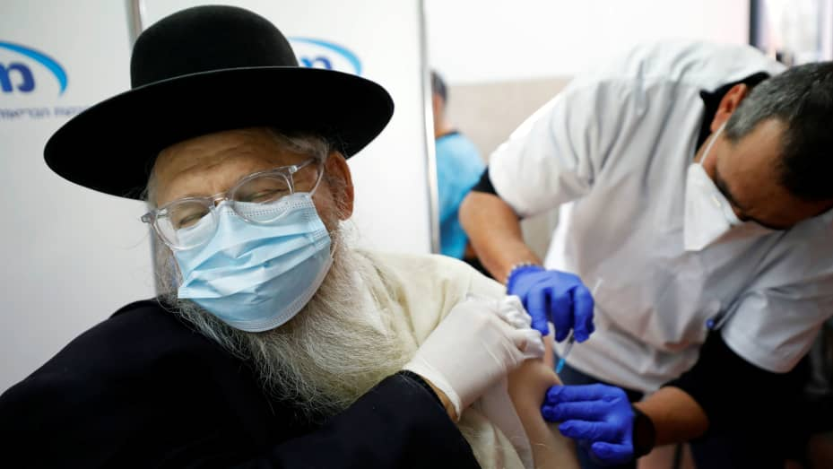
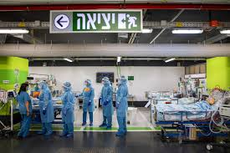
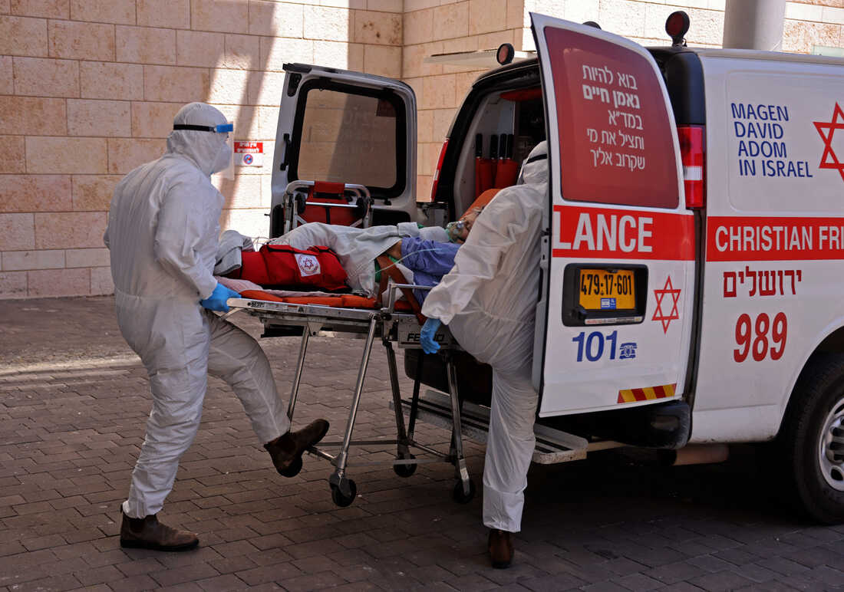
Some key factors
Only public hospitals admit emergency cases
Very strong primary heath care system
During emergencies – ONE system
Israel crisis management: town - national

Slide 4
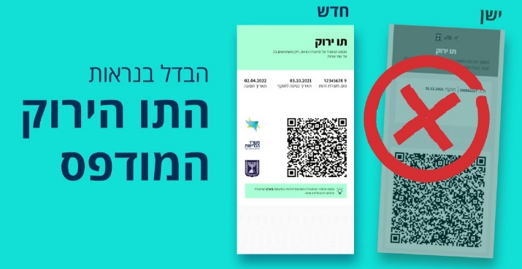
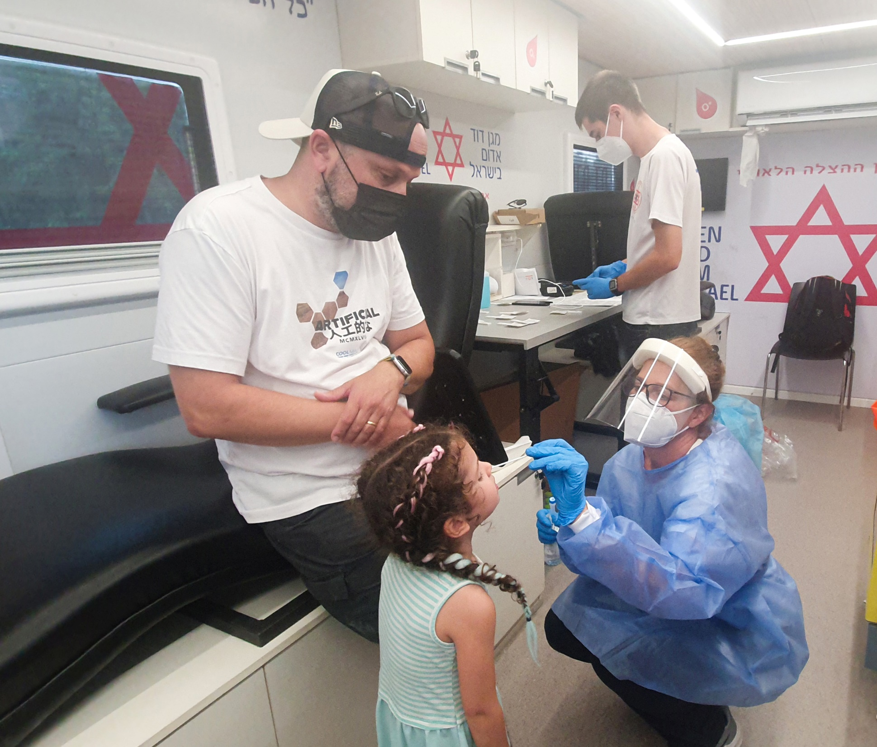
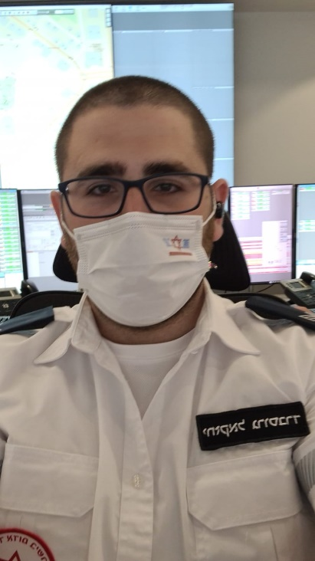
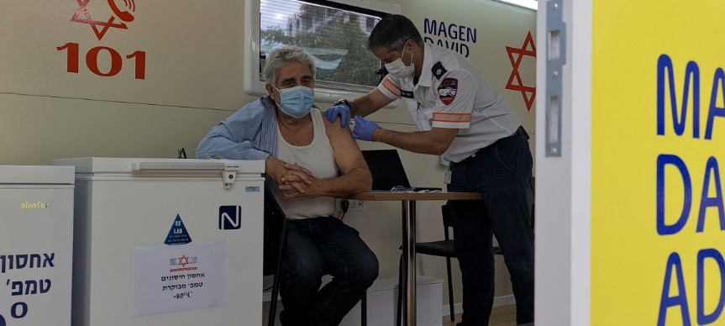
It starts at the community -
“Green pass”
Vaccines
Testing
Safety measures

Slide 5
Then it goes to the hospitals
Patients hospitalized
Patients hospitalized
Non vaccinated
Partially vaccinated
Expired vaccine
Fully vaccinated
Minimal
Moderate
Severe
Critical

Slide 6
And to primary health care

Slide 7
This is how successes looks like

Slide 8
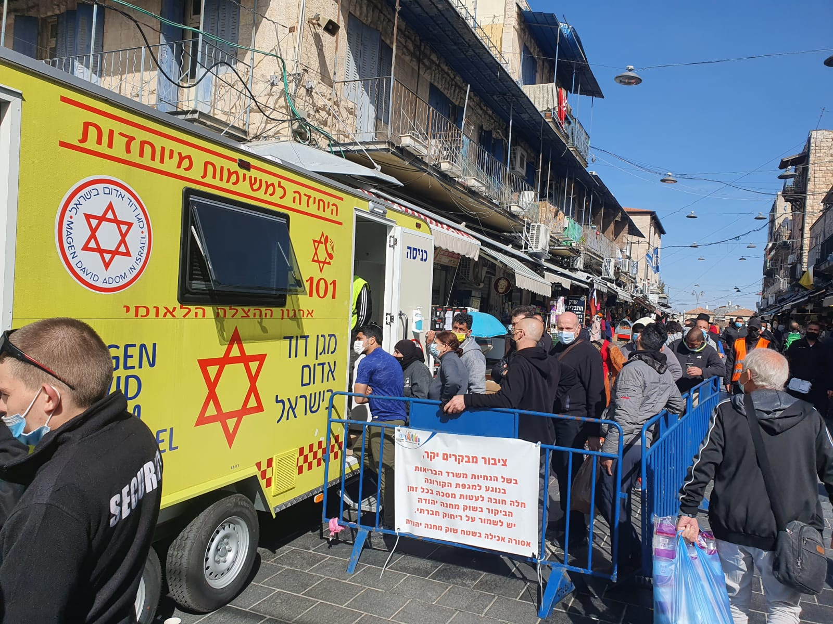
What have we learned?
Community engagement
Trust

Slide 9


Thank you for
your attention
Stay safe.
Take good care of yourself,
yours and your team!

